Slide 1



UX Design Fundamentals
Stefan Ivanov
UX Manager
Infragistics
https://www.infragistics.com/

Slide 2
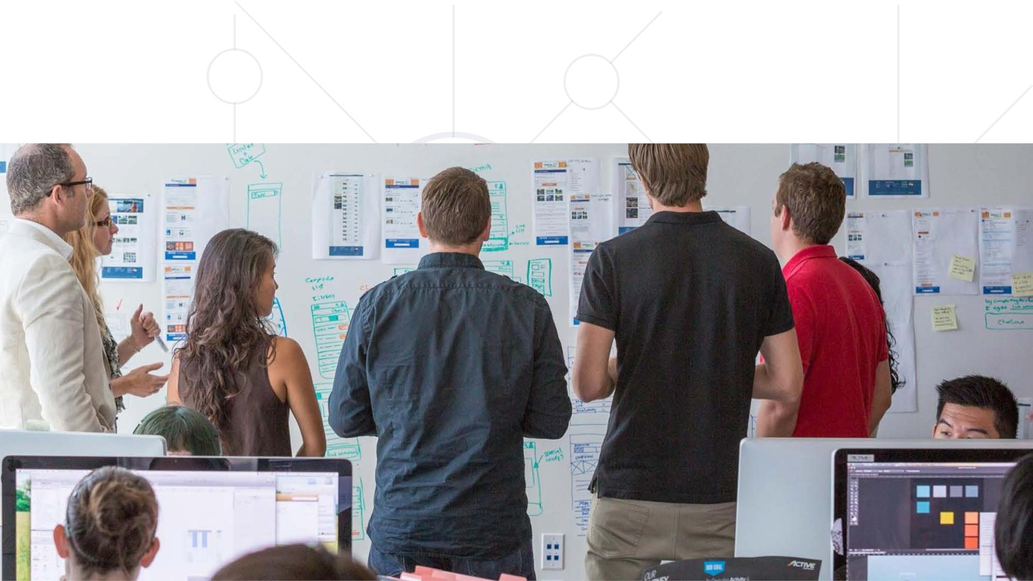
Why is it that some products sꢀnk?
And why User Experience?

Slide 3
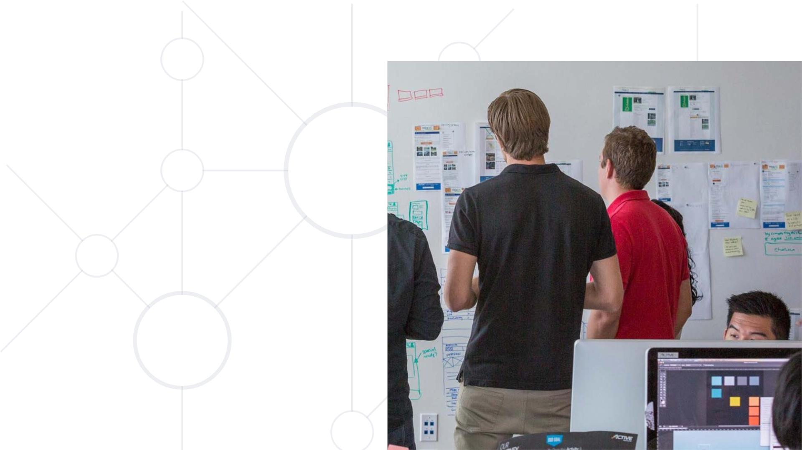
Here’s why…
§ UX is a force for the good
§ The world needs more of it
§ We can make it happen

Slide 4


Slide 5

What is User Experience?
User
Needs
Business
Goals
UX
Information

Slide 6
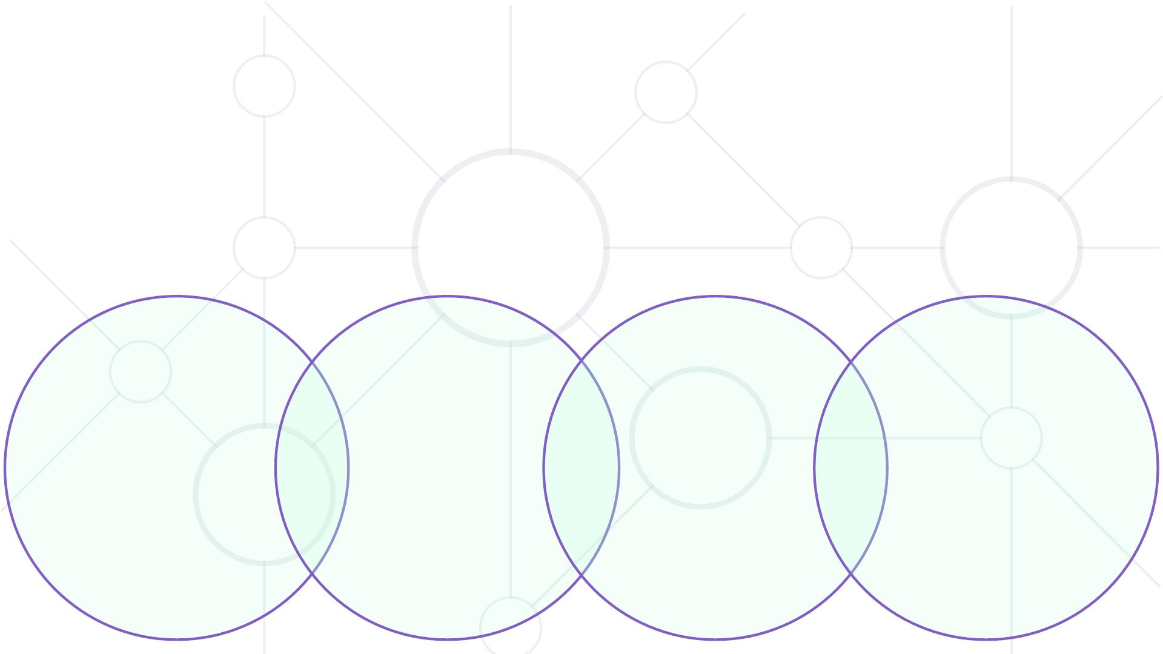
UX is a mix of several disciplines
Interaction Design /
Visual
Design
User
Research
Content Strategy /
Copywriting
Information
Architecture

Slide 7

Project Submission
1 pos & 1 neg
storyboard
2 scenarios
1 persona
1 detailed
user journey
5-screen
paper prototype
feedback on
paper prototype
5-screen
interactive prototype
remote usability
study with 10 people

Slide 8

Sli.do
#UX-web

Slide 9

Agenda
§ The human processor model
§ Fitt ’s law
§ Conceptual models
§ Gestalt principles
§ The seven stages of action
§ Mappings, affordances and constraints
§ Types of knowledge
§ Errors and mistakes

Slide 10
The human processor model
§ 80’s Card, Moran, Newell
§ Coexistence of perception, memory, movement
§ Reference for analyzing human input/output

Slide 11
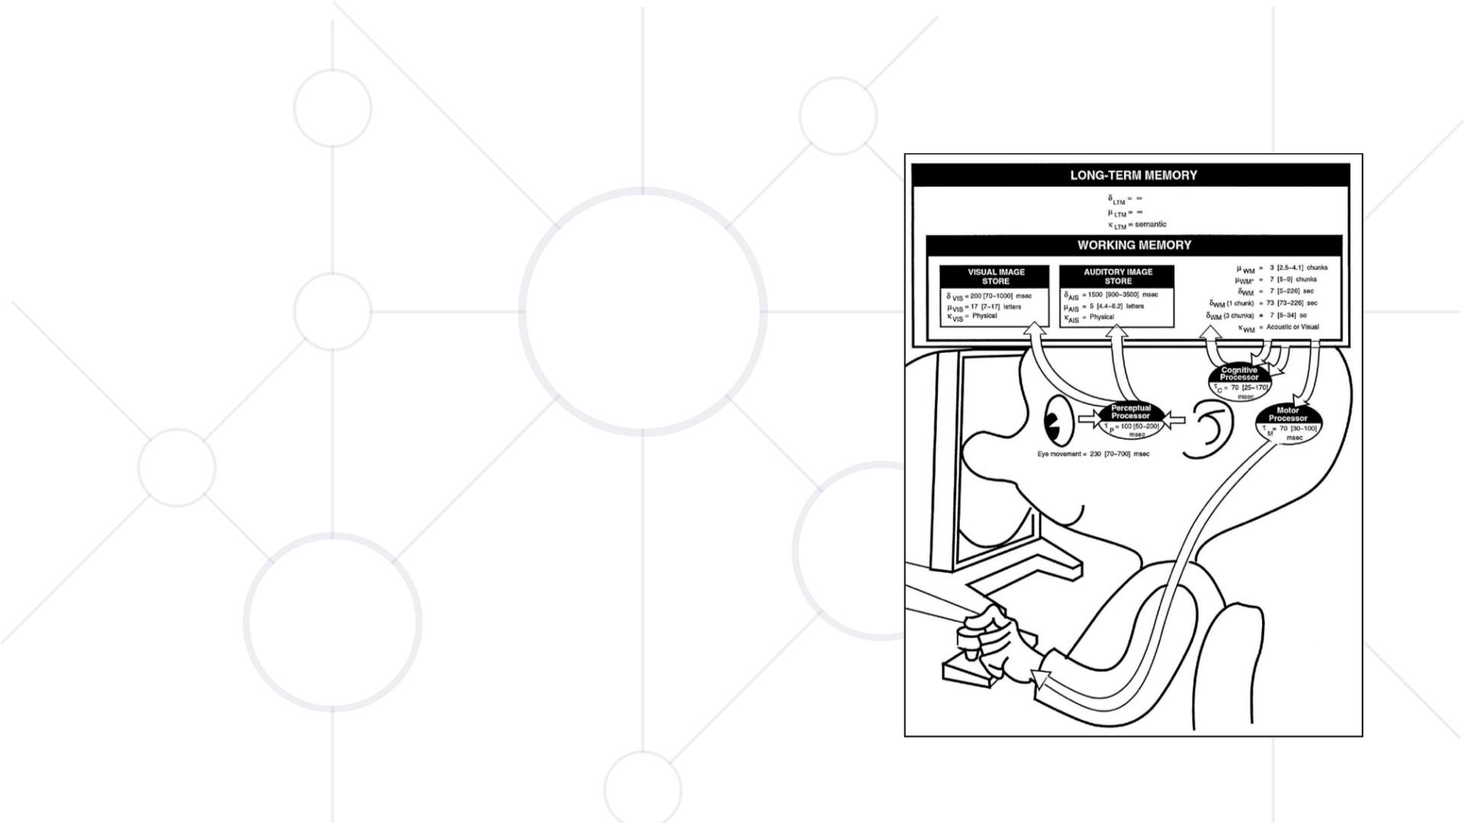
The human processor model
• Three processors and three
types of memory
• Slow man, Middle man and Fast
woman

Slide 12

Perceptual processor and memory
• Buffers for immediate storage and
processing
• 100ms perception time
• Defines rate of 10 fps as absolute minimum
• Decreases with lesser light

Slide 13
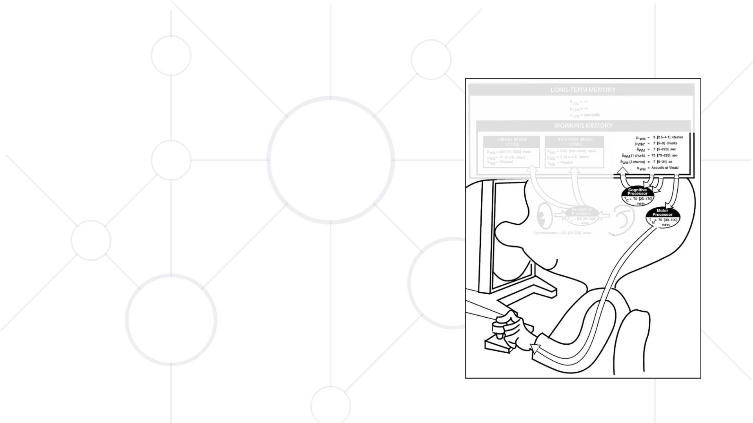
Cogniꢀve and motor processor and
working memory
• Object recognition
• 70ms cognition time
• Drive for corrective action
• 70ms movement time

Slide 14
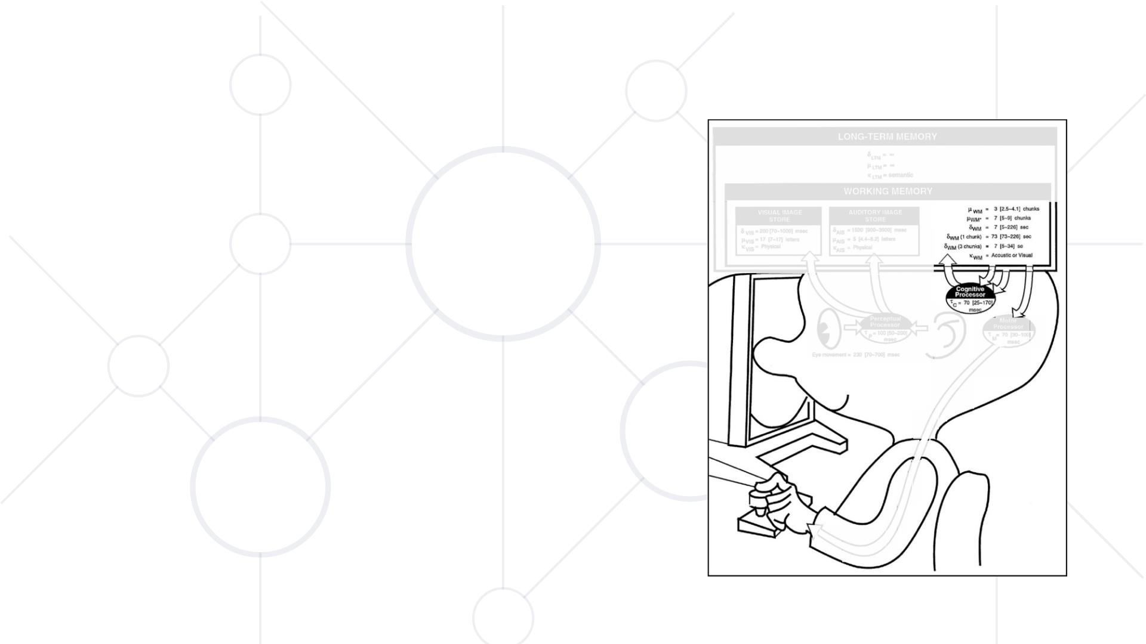
Cognitive and motor processor and
working memory
• Miller ’s number 7±2 cognitive items
• 73s to memorize one information unit
• 7s half life of the information
• Working memory is used for decoding
visual and audial stimulus once perceived

Slide 15
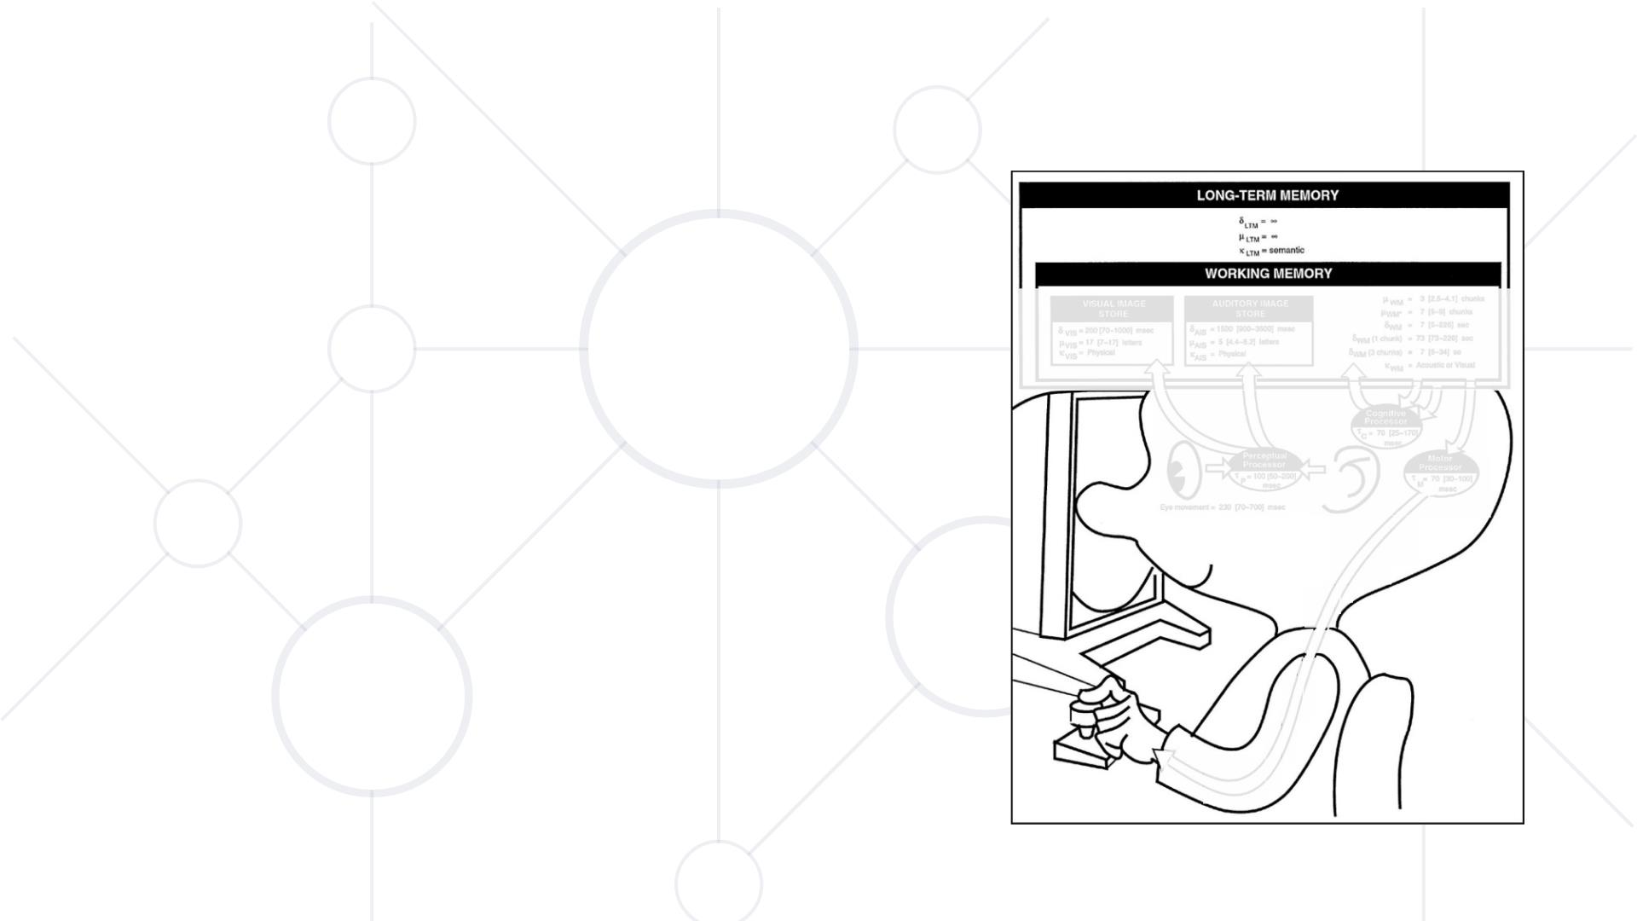
Long-term memory
§ Inﬁnite capacity and half life
§ Based on associaꢀons
§ Slow to write but quick to access
§ Opꢀmal learning when 7s are available to
memorize individual unit of informaꢀon

Slide 16

Experiment
What is your car license plate?

Slide 17
Experiment
What is your car license plate?
Write down 5 numbers and read them out loud to your partner.
e.g. 32 48 75 38 95

Slide 18
Experiment
What is your car license plate?
Write down 5 numbers and read them out loud to your par tner.
Then let him count from 50 to 1(in reverse).

Slide 19
Experiment
What is your car license plate?
Write down 5 numbers and read them out loud to your par tner.
Then let him count from 50 to 1(in reverse).
Make him reproduce the 5 numbers.

Slide 20
Experiment
Now let’s do it together with 9 numbers that I am going to read
out loud to you.

Slide 21
Experiment
Count from 50 to 1(in reverse) and try to reproduce the 9
numbers.

Slide 22
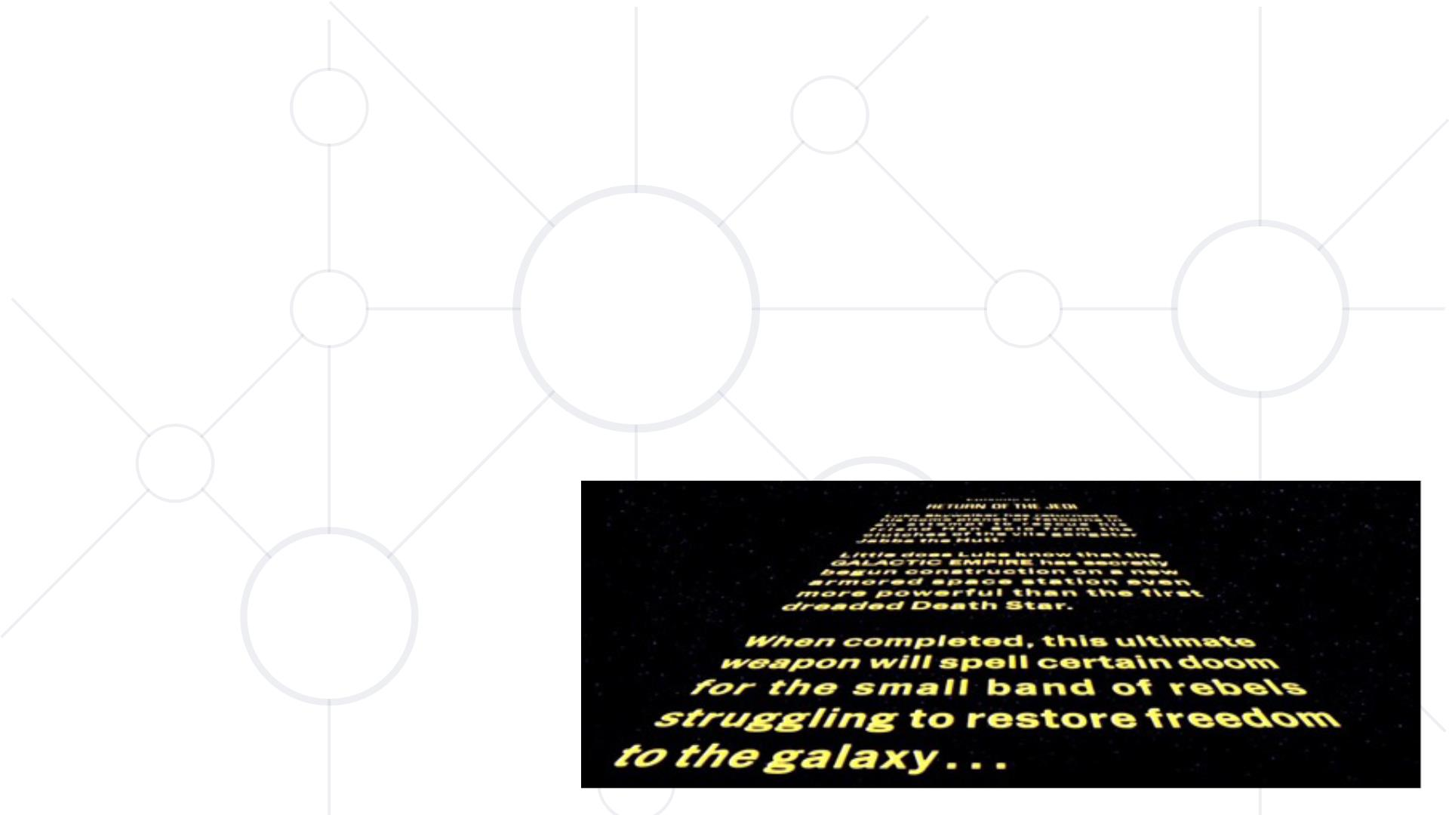
Eye saccades
§ 13 characters per
movement
§ 11 words per
second

Slide 23
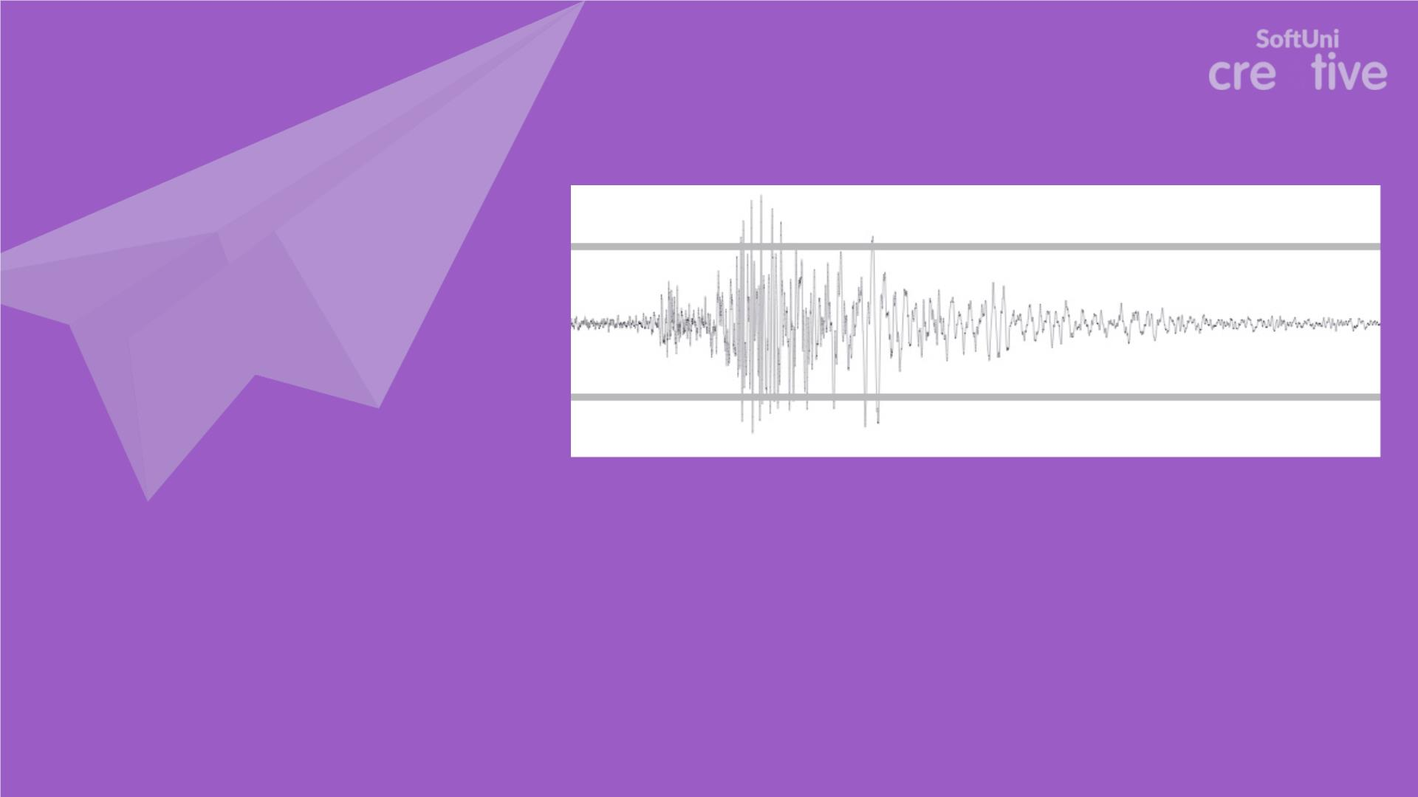
You may try this at home
100
70
70
-------
240
Draw a zig zag line for 5 seconds between two parallel lines trying to end as
close to the lines as possible.

Slide 24
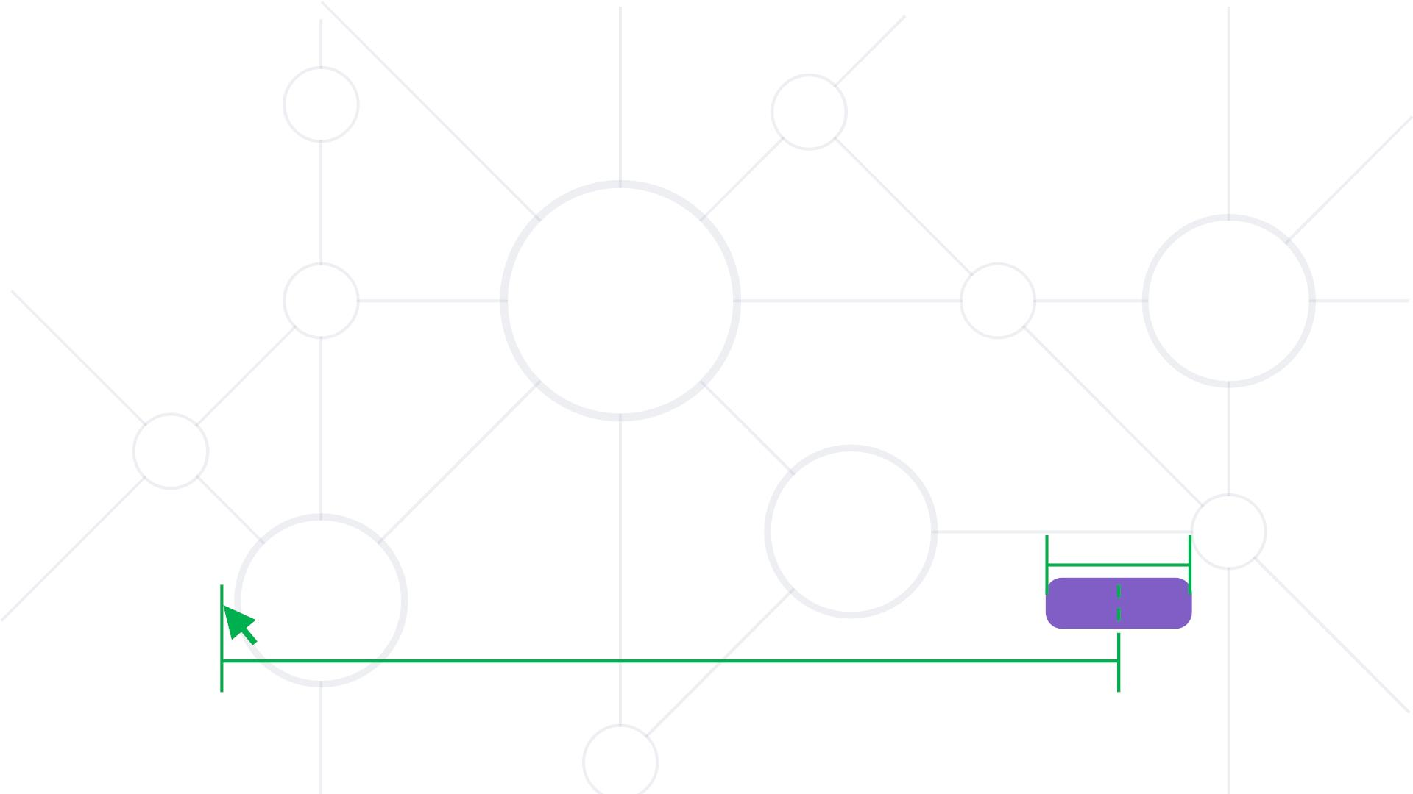
Fitt ’s law
Predicꢀon for the ꢀme necessary to press a buꢁon, based on
the distance to it and its size
Tpos=ꢀꢁ ∗ꢀꢂ ꢃꢄ IM=100
ID=log_2⁡(2ꢂ⁄ꢅ)
W
D
BUTTON

Slide 25

Fitt ’s law
§ Ta p for 3 seconds between the pair
of lines switching from leꢀ to right
and vice versa every ꢁme
§ Doubling distance between target
adds constant ꢁme
§ Doubling the target sizes reduces
similarly to decreasing the distance
between targets

Slide 26
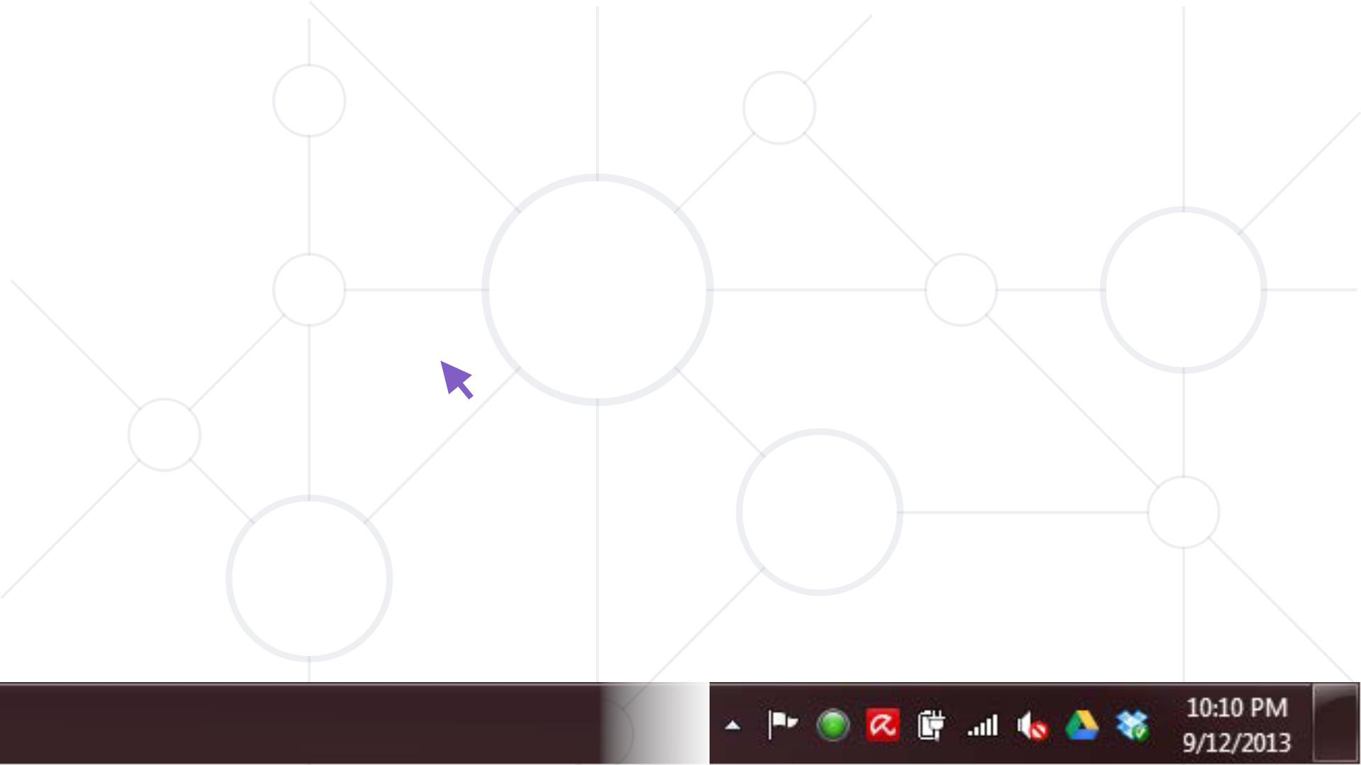
Fitt ’s law

Slide 27
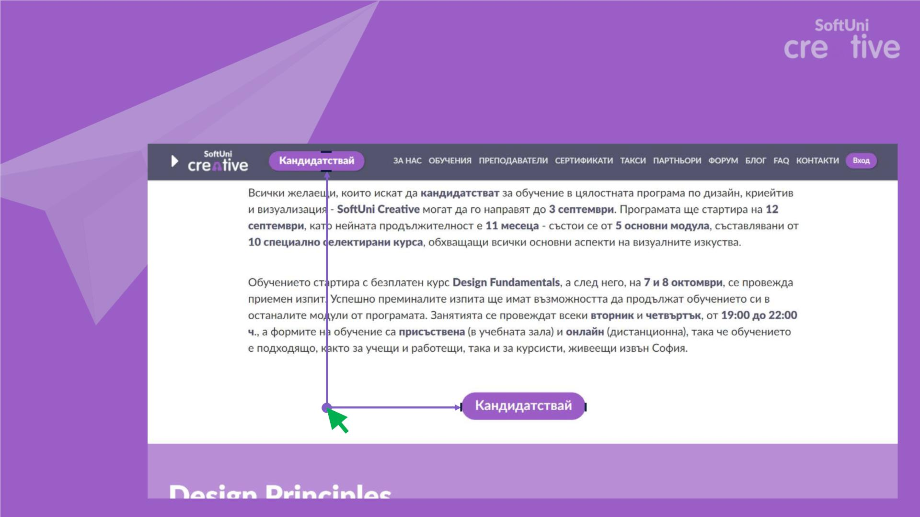
Experiment
20px
450px
120px
200px

Slide 28

Experiment
450px
60px

Slide 29
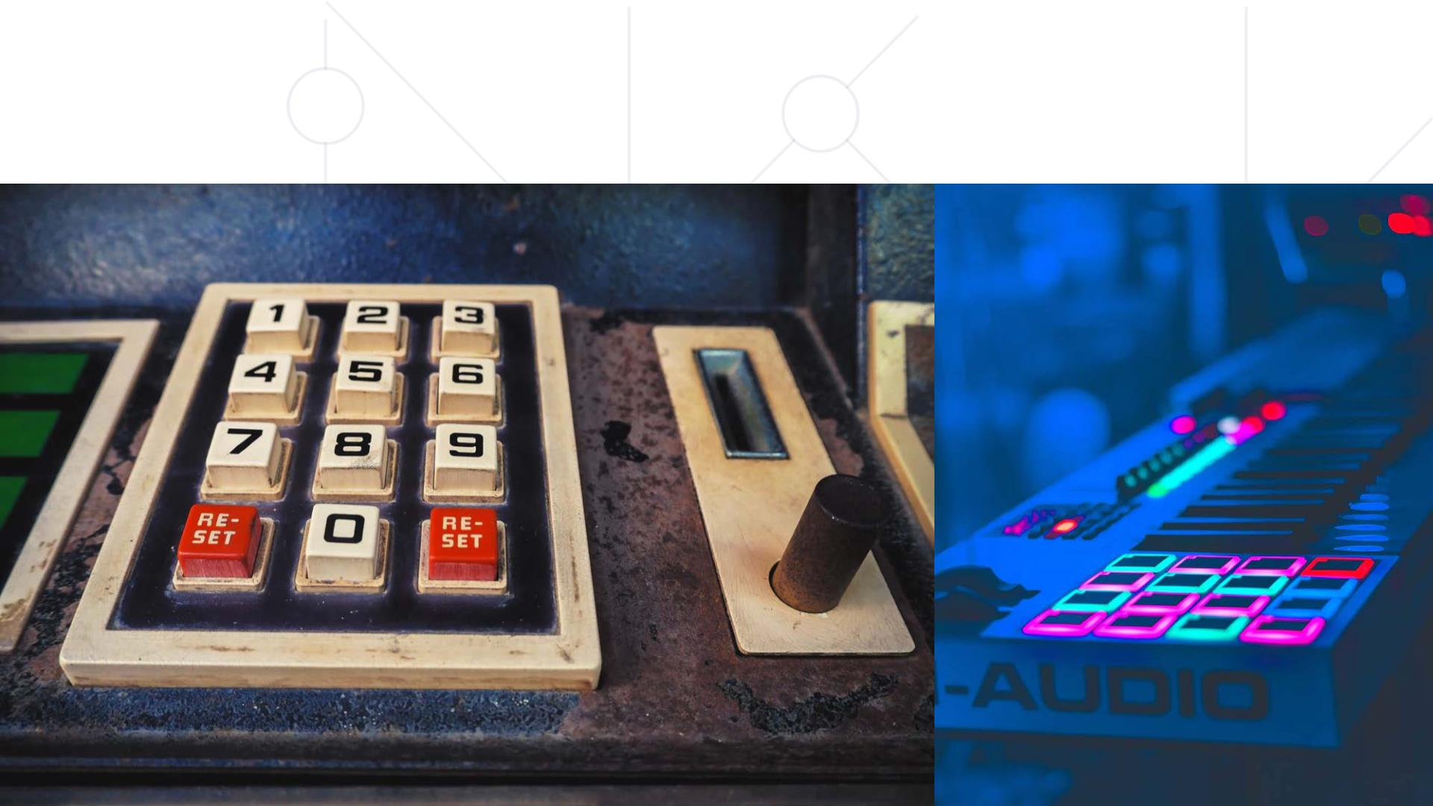
Also works for real objects

Slide 30

Conceptual models
People create conceptual models of how things work

Slide 31
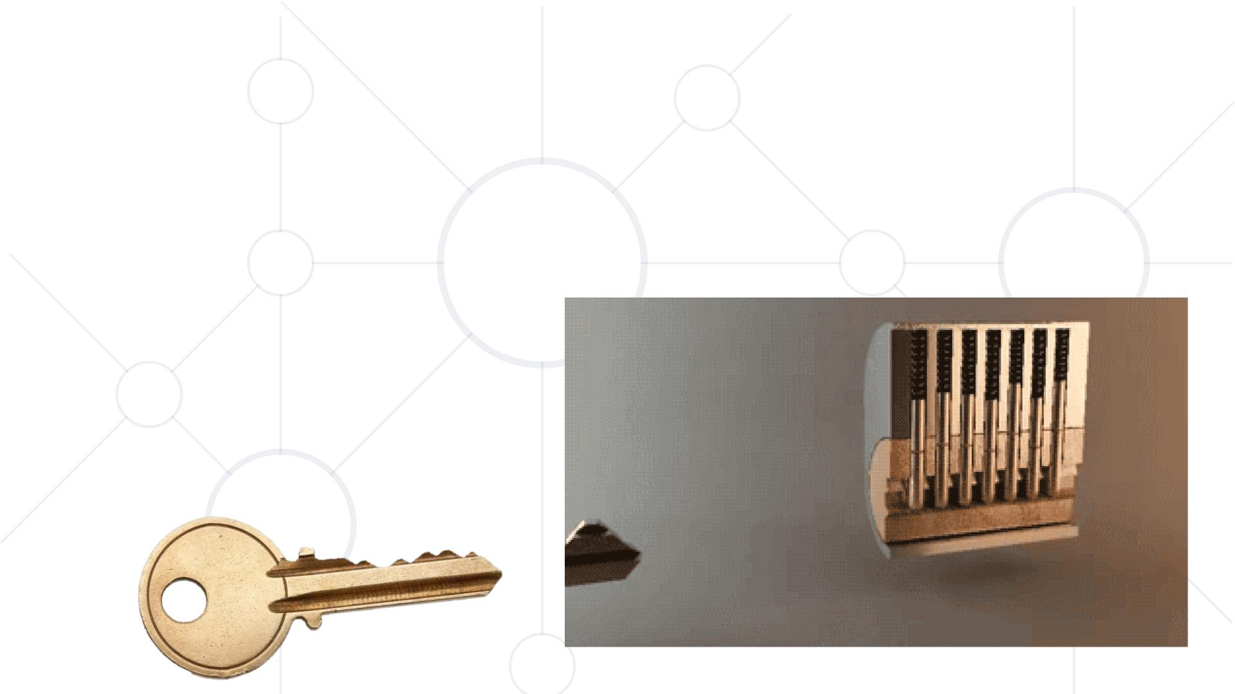
Conceptual models
People create conceptual models of how things work

Slide 32
Conceptual models
The designer ’s goal is to sꢁmulate the creaꢁon of a conceptual
model that is as close as possible to the funcꢁonal model of the
object

Slide 33
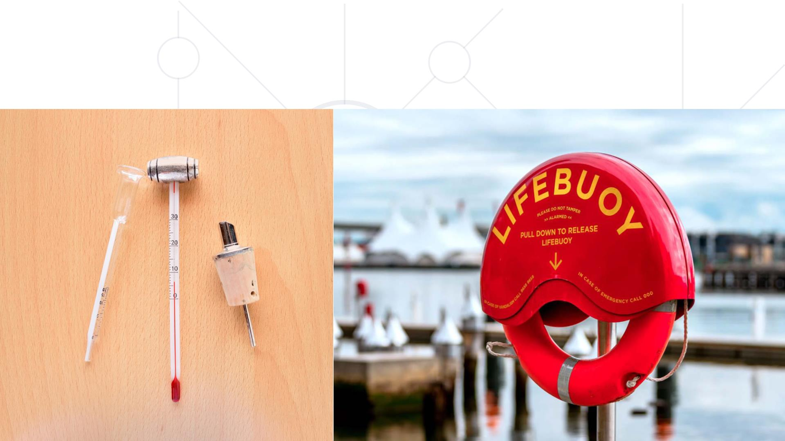
Conceptual models

Slide 34
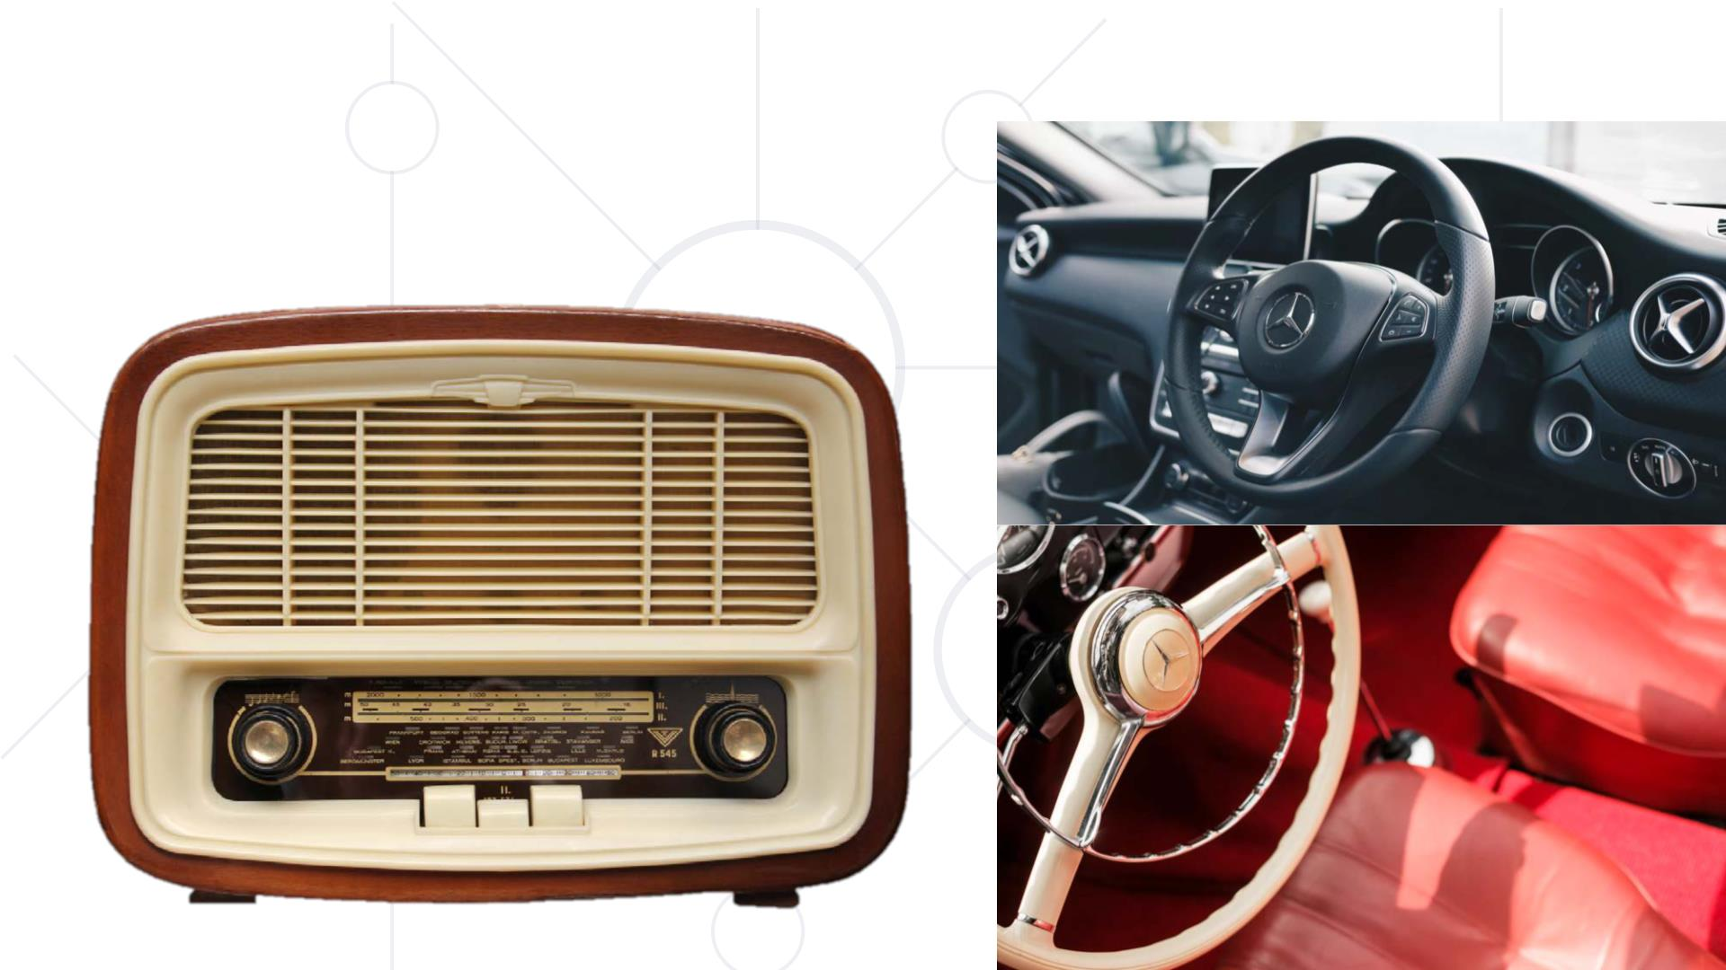
Conceptual models

Slide 35

Conceptual models
§ Allow us to predict the outcome of our actions
§ Abide the rules of good design
§ Use with care mappings and constraints
§ Carefully craft a good conceptual model

Slide 36

Conceptual models
Conceptual
model
Design
model
Conceptual
model
Conceptual
model

Slide 37
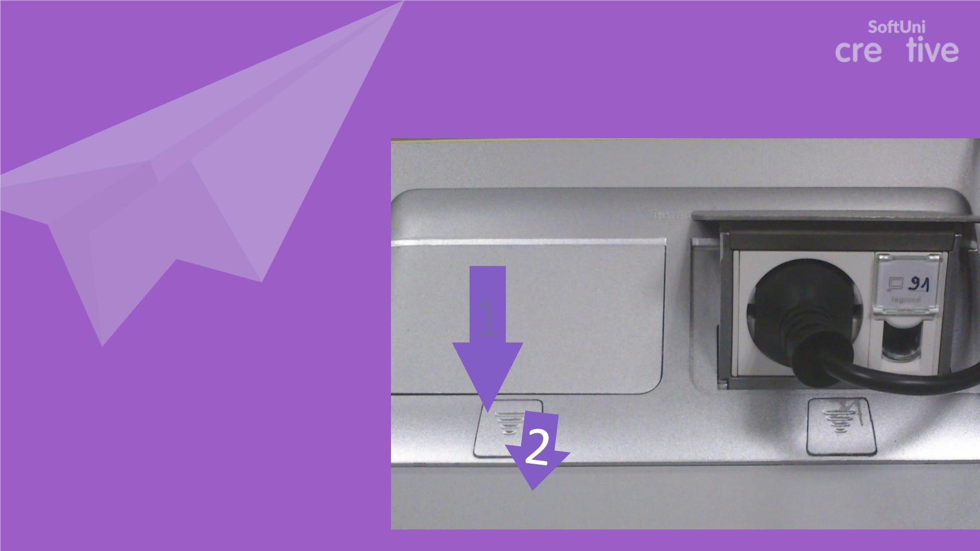
Exercise
1
Share a frustrating
experience of yours
that was due to the
mismatch between the
models

Slide 38
Gestalt principles
§ Wertheimer, Kohler & Kofka in early 20th century
§ The whole is more than the sum of its parts
§ Based on human perception
§ Perception of belonging
§ Guidelines for layout and alignment

Slide 39
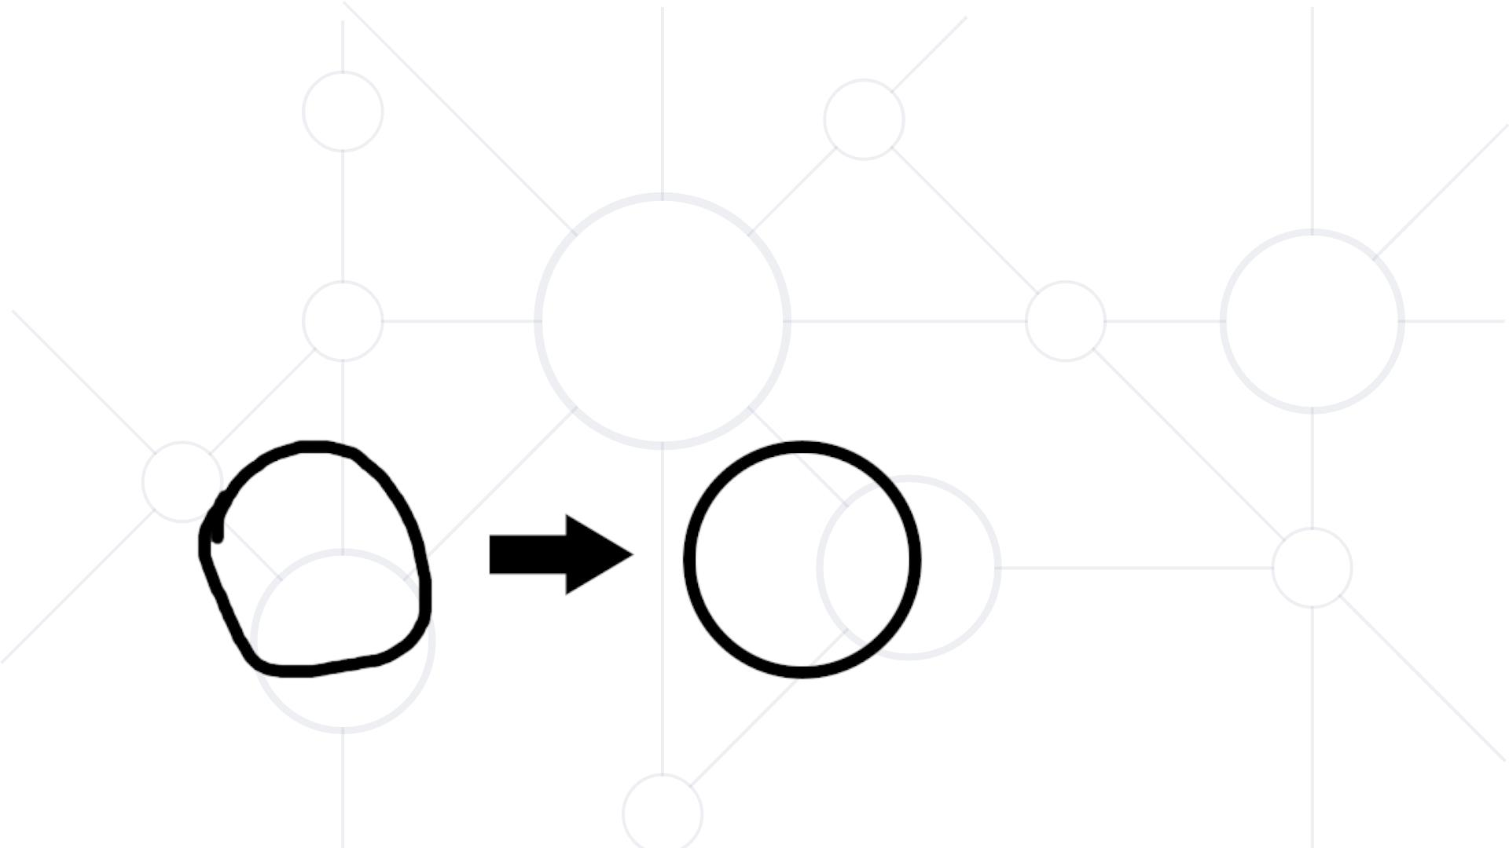
Gestalt principles - Law of good shape
Human brain perfects the shape of an object (natural compressing
algorithm)

Slide 40
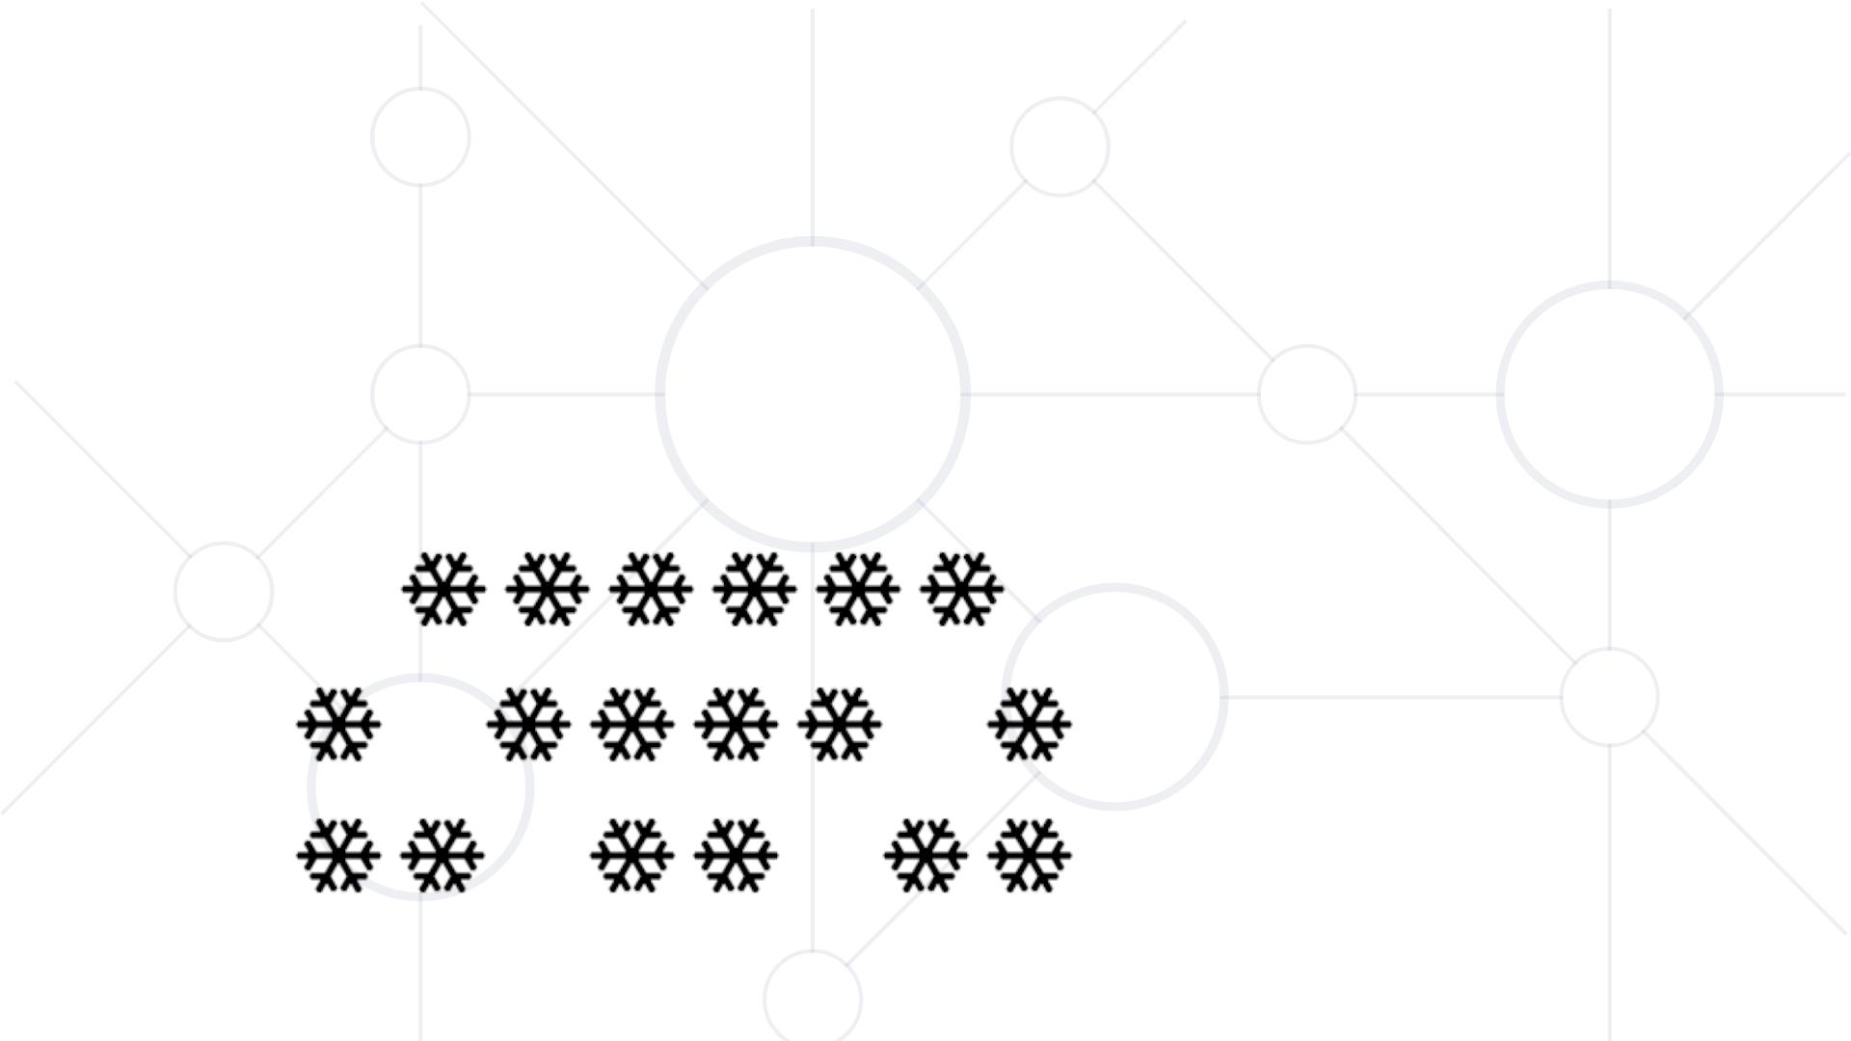
Gestalt principles - Proximity
Objects nearer to one another are perceived as belonging
together

Slide 41
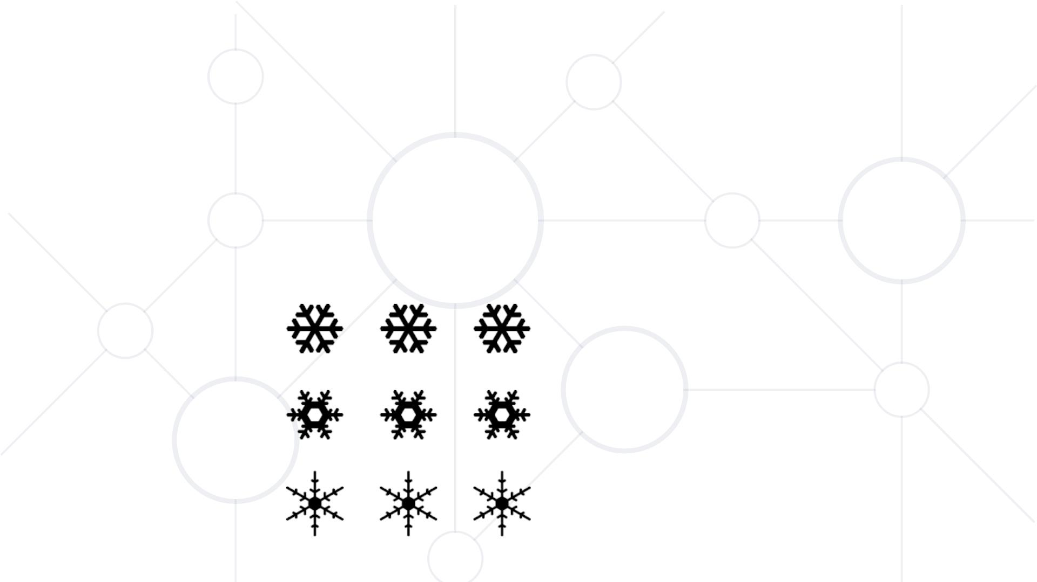
Gestalt principles - Similarity
Objects that are similar to one another are perceived as belonging
together

Slide 42
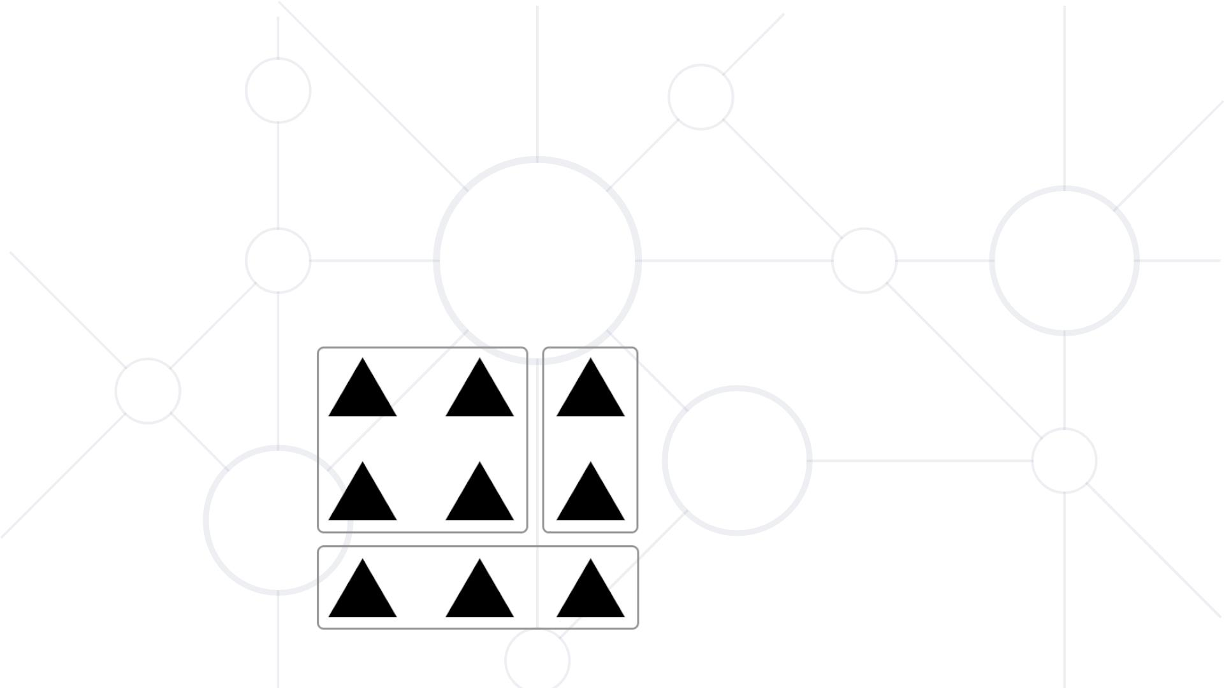
Gestalt principles - Closure
Objects situated within an enclosed area are seen as a group

Slide 43

Gestalt principles - Previous experience
Human brain relies on previous experience when perceiving and
interpreting information

Slide 44
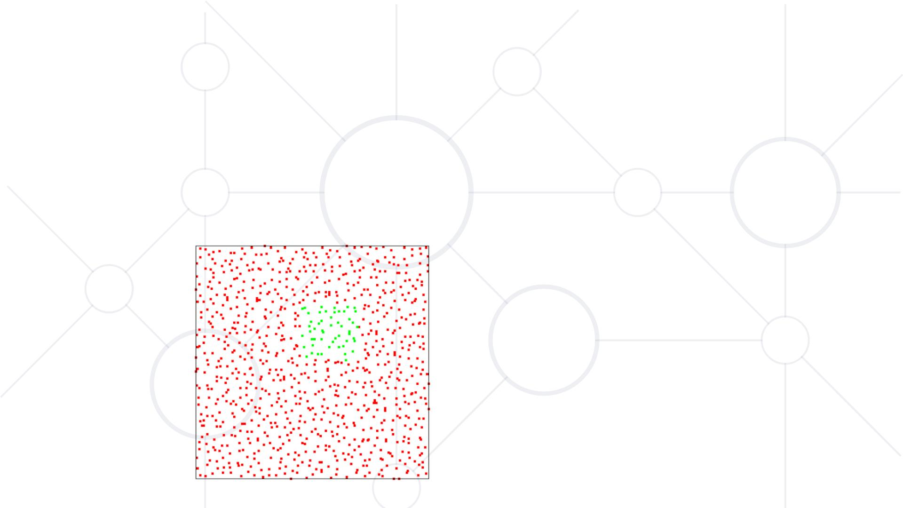
Gestalt principles - Common faith
Objects with idenꢁcal behavior are perceived as one

Slide 45
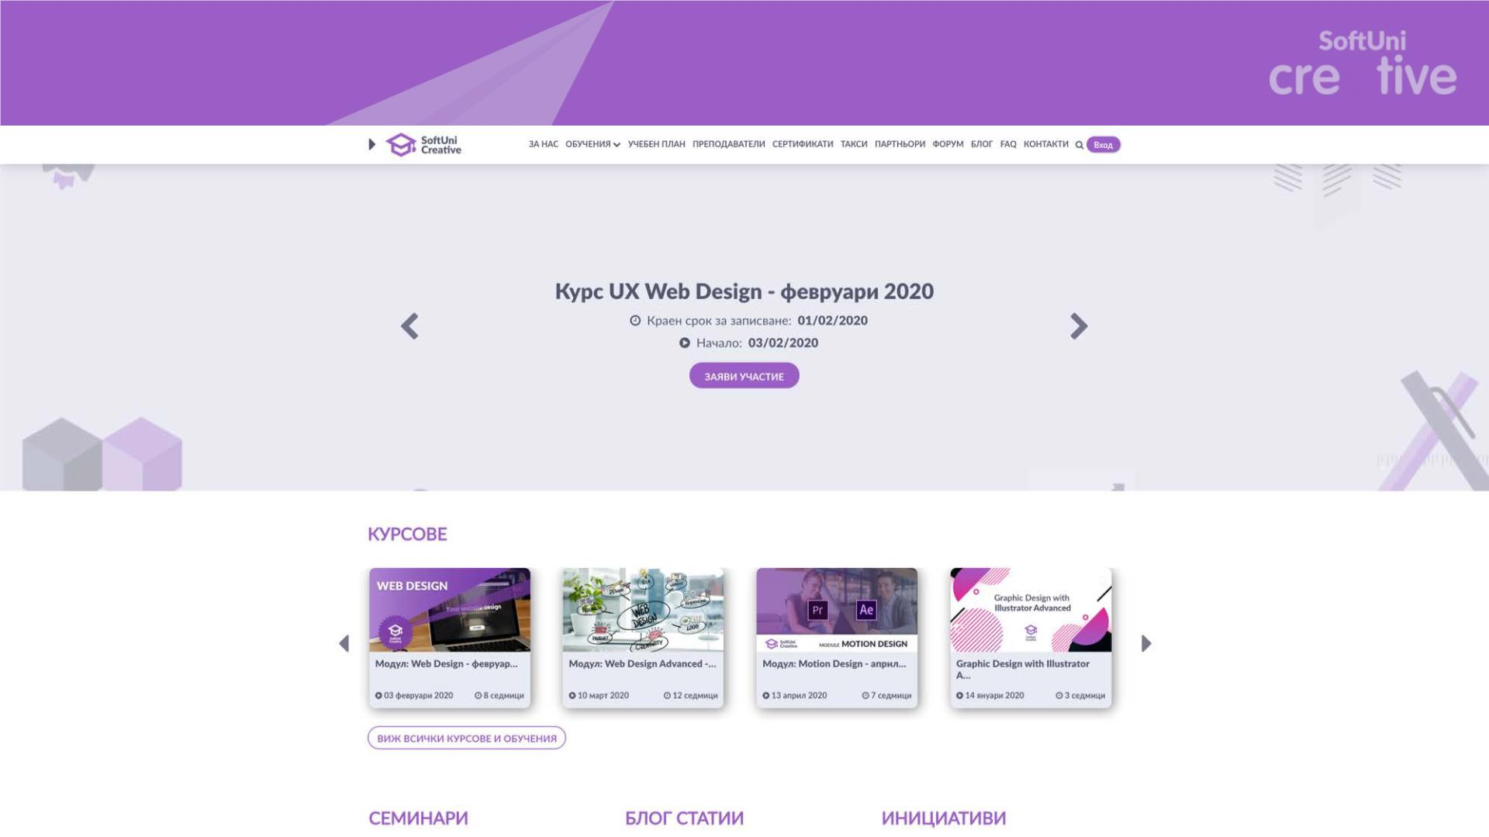
Exercise

Slide 46
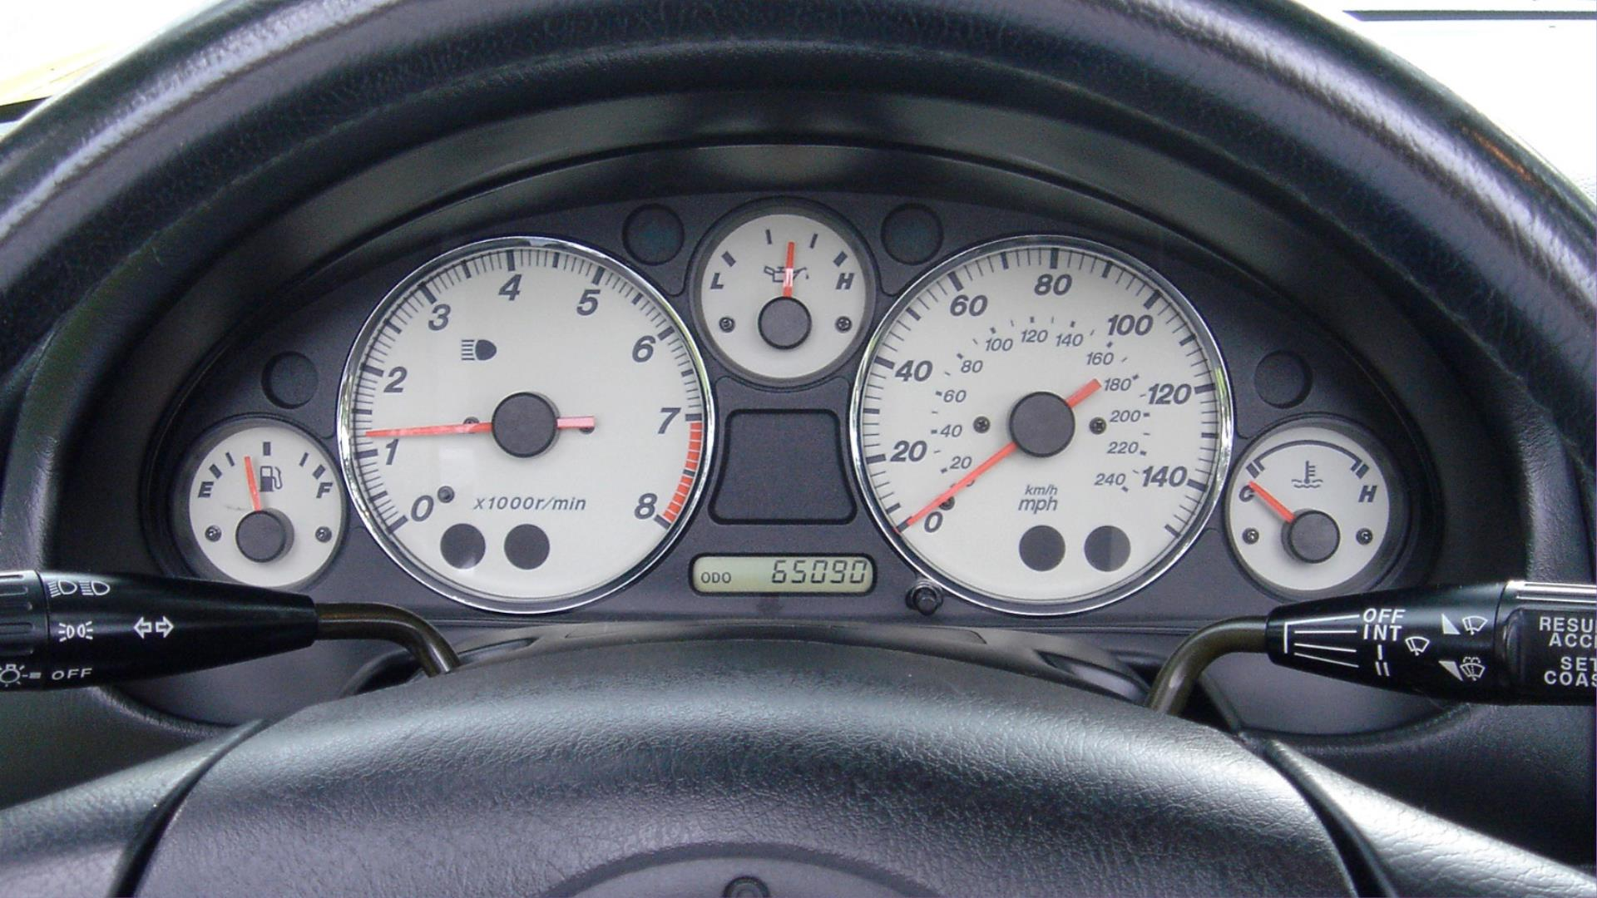

Slide 47

The seven stages of action
Goal
Action
Evalua
ꢀon
§ Why do we fail upon
encountering new products?
§ What is the model of our
interactions with the surrounding
world?
Environ
ment

Slide 48

The seven stages of acꢀon
Goal
Intention
Actions
§ Abstract goals
§ Define an intention
§ Sequence of actions
§ Execution
Execuꢀon

Slide 49

The seven stages of action
§ There are always multiple paths
towards achieving the same goal
§ What if I were driving towards
the sun and it was blinding me

Slide 50

The seven stages of acꢀon
Goal
Comparison
Interpretation
Percepꢀon
§ Evaluation has also three phases
§ Perception of the environment
§ Interpretation of the state
§ Comparison if the goal was
reached

Slide 51

The seven stages of action
Goal
Intention
Acꢀons
Comparison
Interpretation
Perception
§ Why do we fail upon
encountering new products?
Execution
§ What is the model of our
interactions with the surrounding
world?
Environ
ment

Slide 52
The seven stages of acꢀon
§ They always happen in cycles
§ We don’t follow them strictly all the time
§ They work only for simple goals and tasks
§ The model is not applicable for goals that we faced in a random
fashion

Slide 53

Example
§ It is dark
§ I need more light
§ I will go to the light switch and
switch it on
§ I go to the switch and flip it
§ I perceive the light intensity in the room afterwards
§ I interpret that it is now bright in the room
§ I compare the previous and current state and see that my goal was
achieved

Slide 54

Exercise
Goal
Intention
Actions
Comparison
Interpretaꢀon
Perception
Use the seven stages of
action to define your
Execution
own sequence for a task
Environ
ment

Slide 55
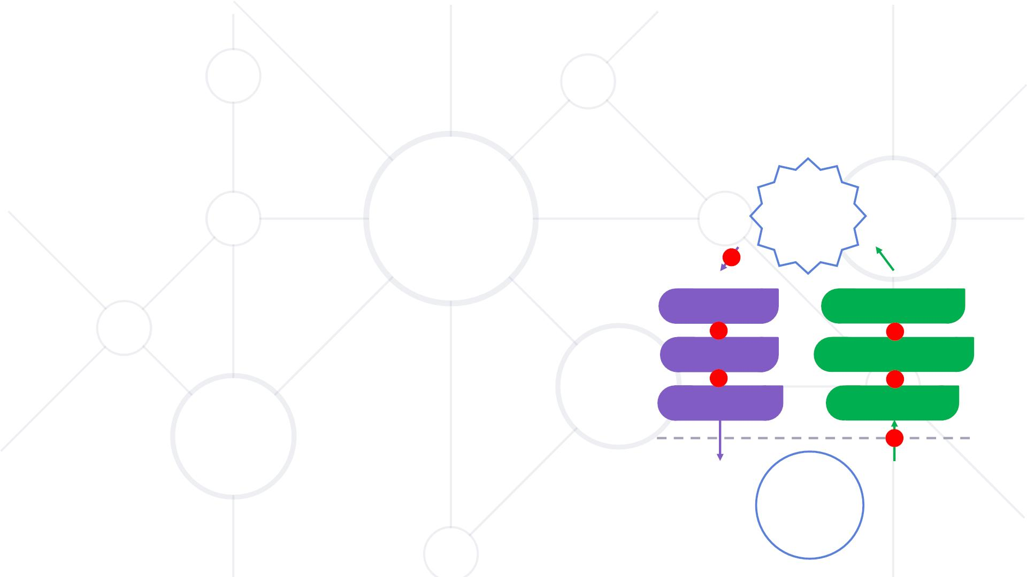
Gulfs
Goal
Intention
Acꢀons
Comparison
Interpretation
Perception
§ Six potential gulfs
Execution
§ Three gulfs of action
§ Three gulfs of evaluation
Environ
ment

Slide 56
The seven stages for beꢁer design
Use them as a design guideline
How easy is it to
§ perceive the system functions?
§ Goal
§ define the possible actions?
§ Intention
§ connect logical and basic actions?
§ perceive the system status?
§ Action sequence
§ Perception
§ Interpretation
§ Comparison
§ interpret the system status meaning?
§ determine if the goal has been achieved?

Slide 57
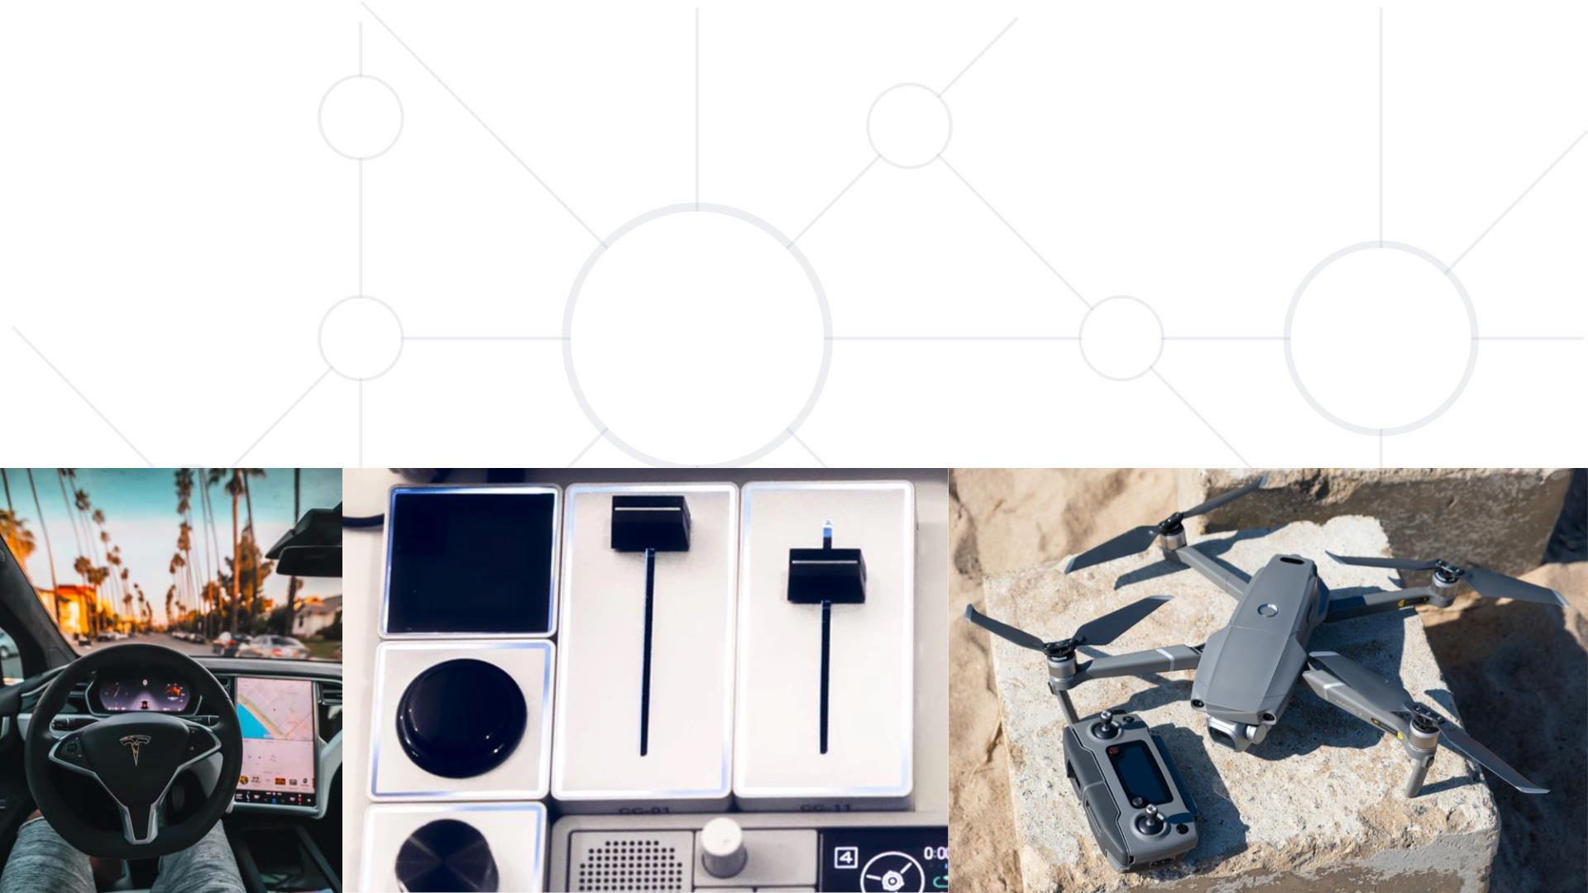
Mappings
§ Show the relaꢁon between interface and the physical world
§ Show the relaꢁon between input and output of informaꢁon

Slide 58
Mappings
§ Natural mappings are based on physical analogies: spatial,
perceptual, biological and cultural
§ They are quick and easy to understand
§ They require no remembering
§ They improve the experience for beginner users

Slide 59

Exercise
What is your take on the position
navigation controls?
What is your take on the controls for
lowering and picking the claw?

Slide 60
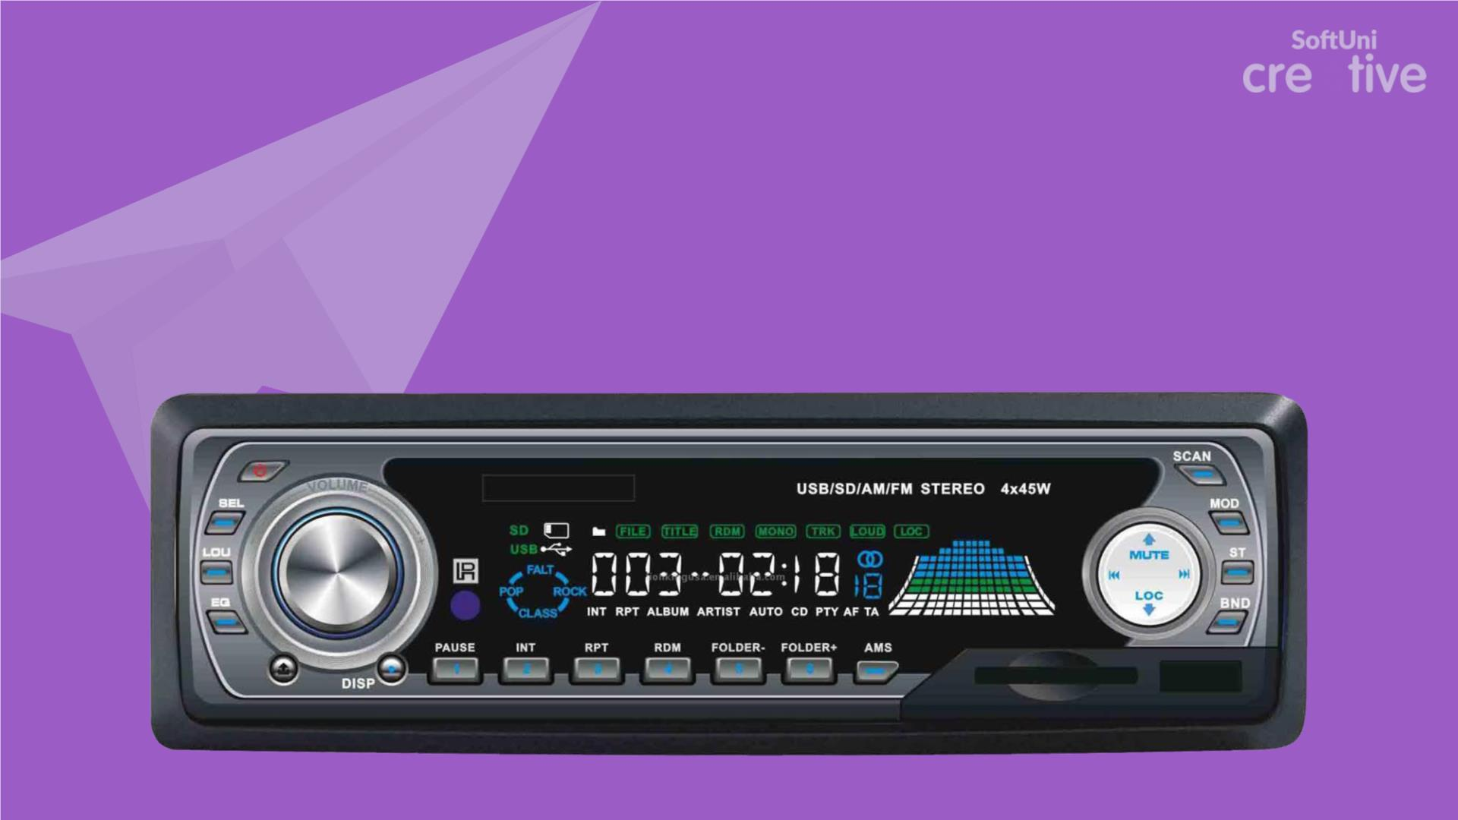
Exercise
Replace the rotar y volume control with a slider. What would
be its orientation?

Slide 61
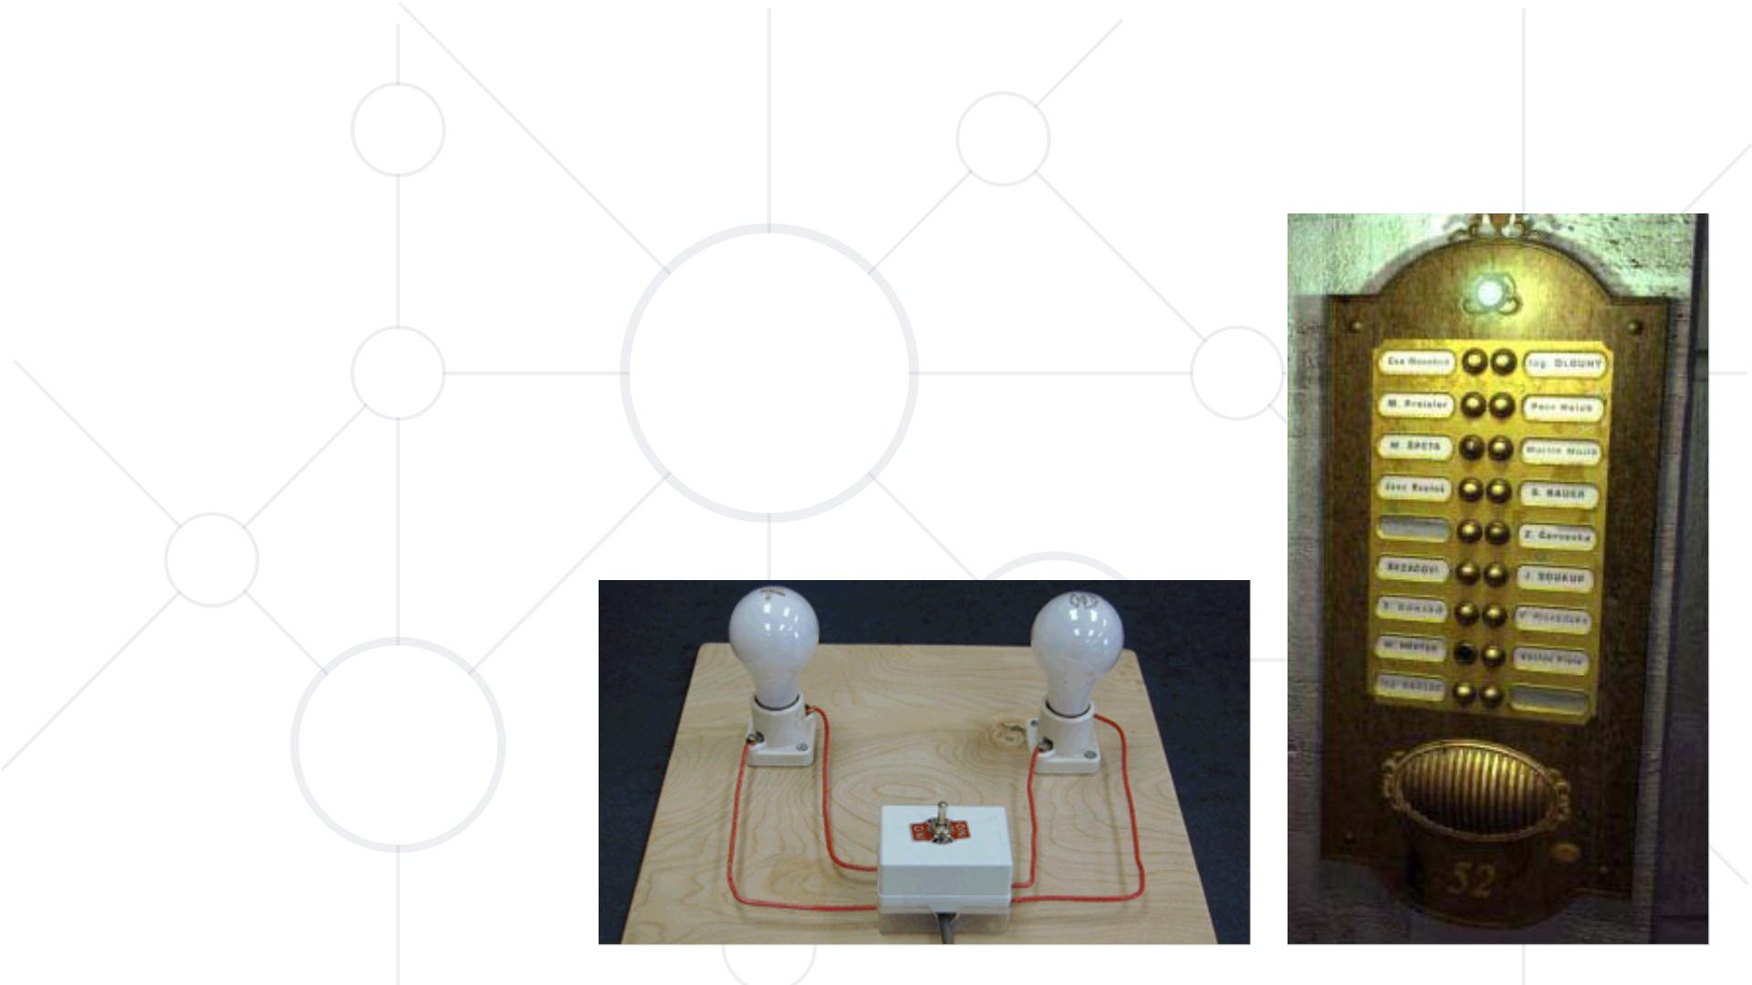
Spaꢀal mappings
§ The most frequently used type of mapping
§ Controls are arranged in a fashion
mimicking the spatial arrangement of the
items they control

Slide 62
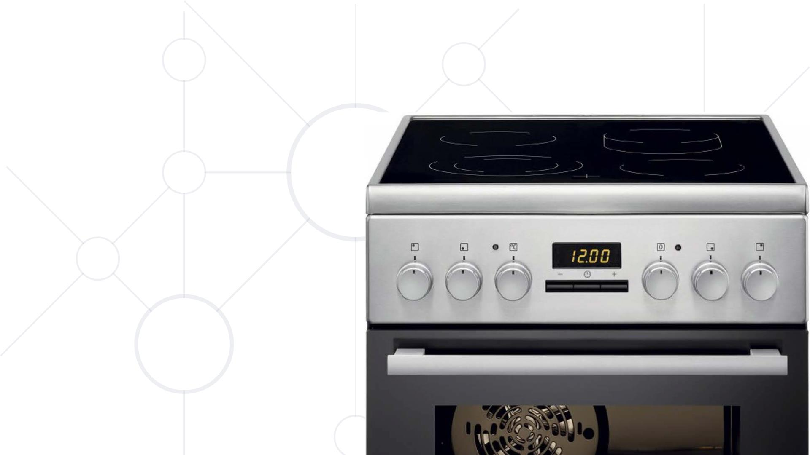
Spatial mappings
§ A cooking stove
§ How are the controls
mapped to the heaters
§ Labeling is not solving a
problem, but rather
hiding bad design

Slide 63
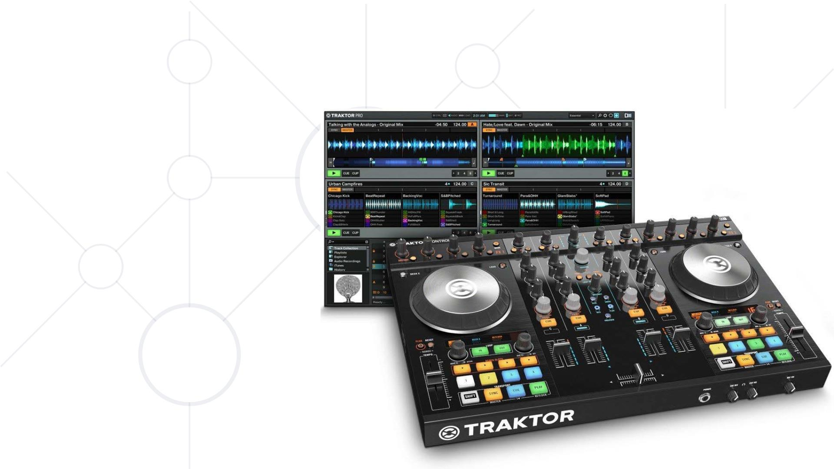
Perceptual mappings
§ Controls for an
object mimic its
physical appearance
§ Form, shape, color,
location

Slide 64
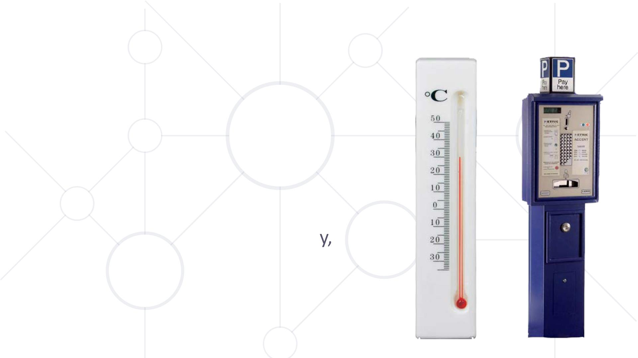
Biological mappings
§ Up means more
§ Valid for additive variables onl
not for substantive
§ Content is laid out top to
bottom

Slide 65
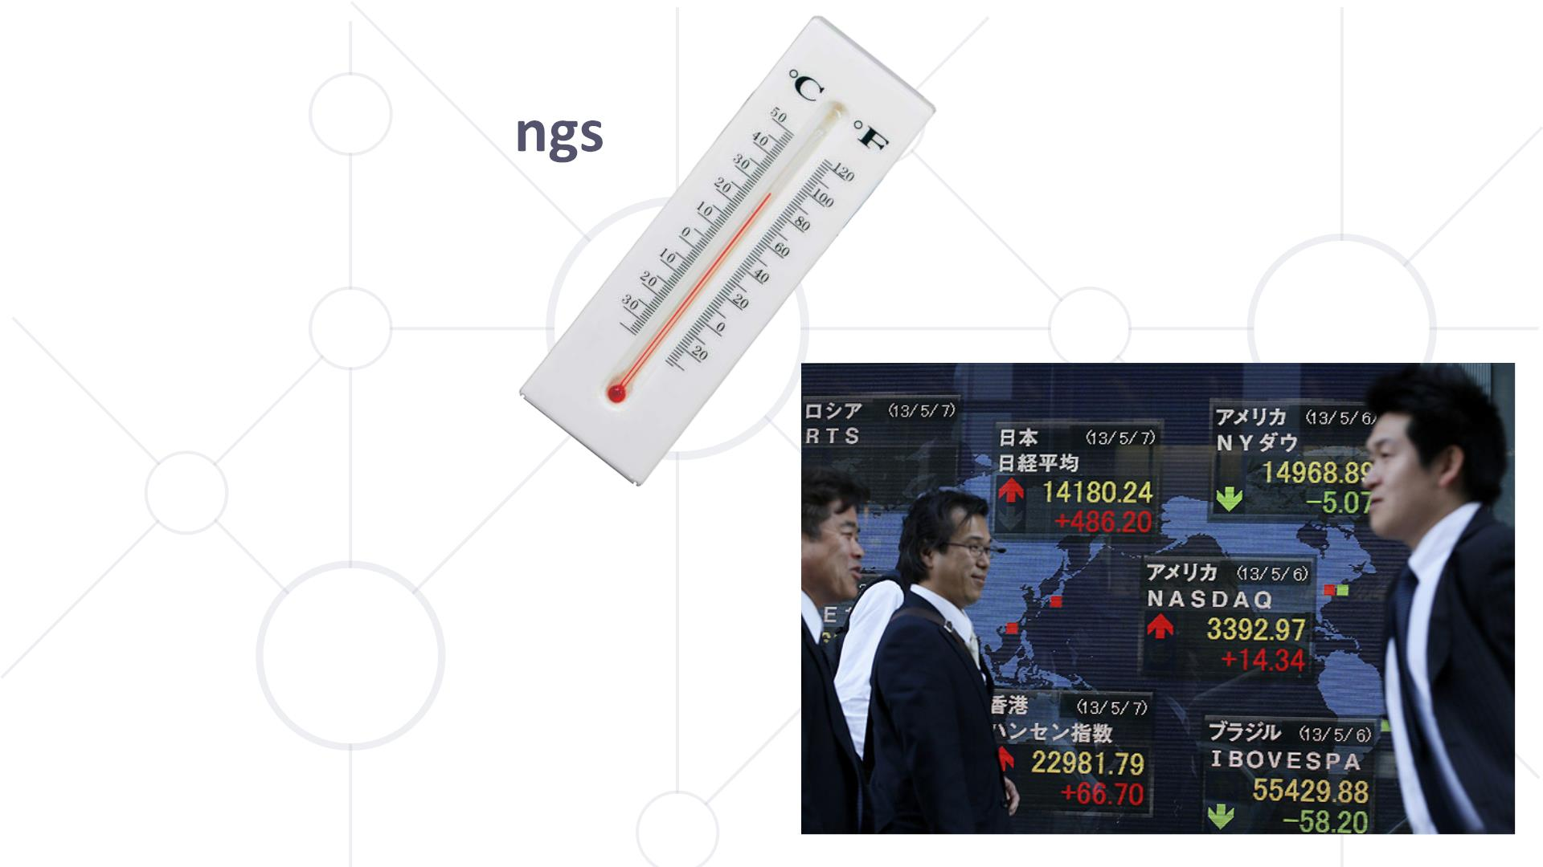
Cultural mappi
§ Celsius and Fahrenheit
§ Red means decrease in
western and increase in
eastern cultures

Slide 66

Affordances
Properꢁes put in the design of a
product suggesꢁng to the user
how it can be used
• Intentionally suggest to the user
scenarios for using the product
• No need for labels, instructions and
tutorials
• Work for simple functionalities only
• Improve the usability of the product
• False affordances

Slide 67
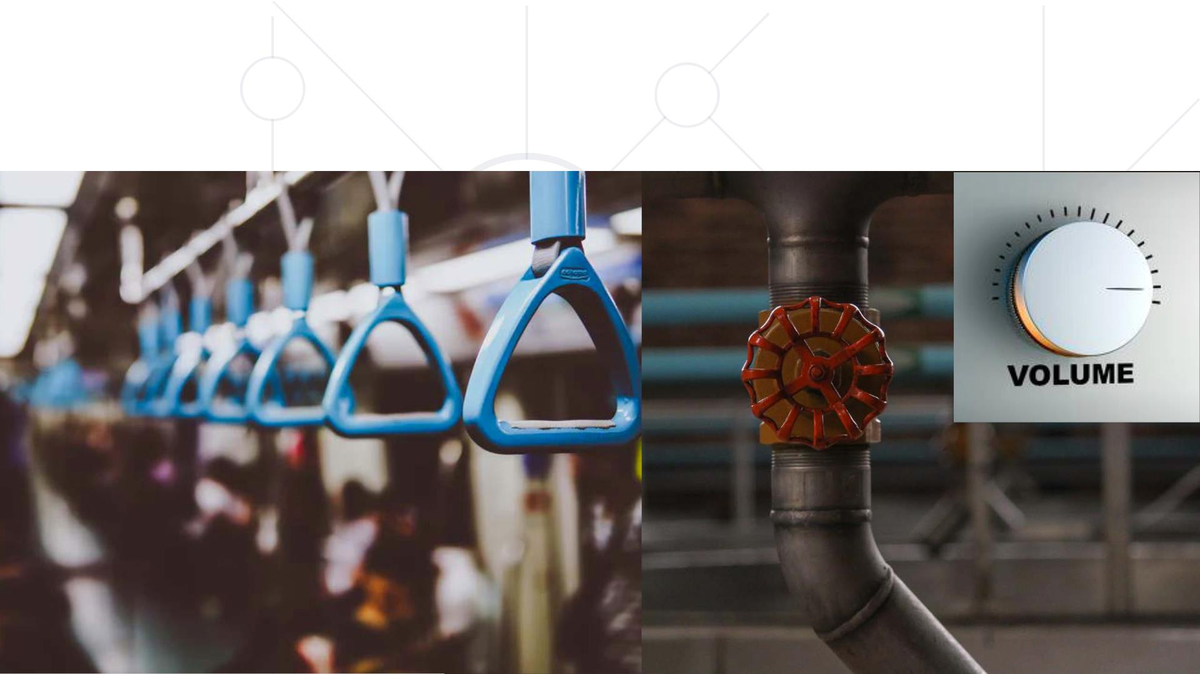
Affordances

Slide 68

Exercise

Slide 69
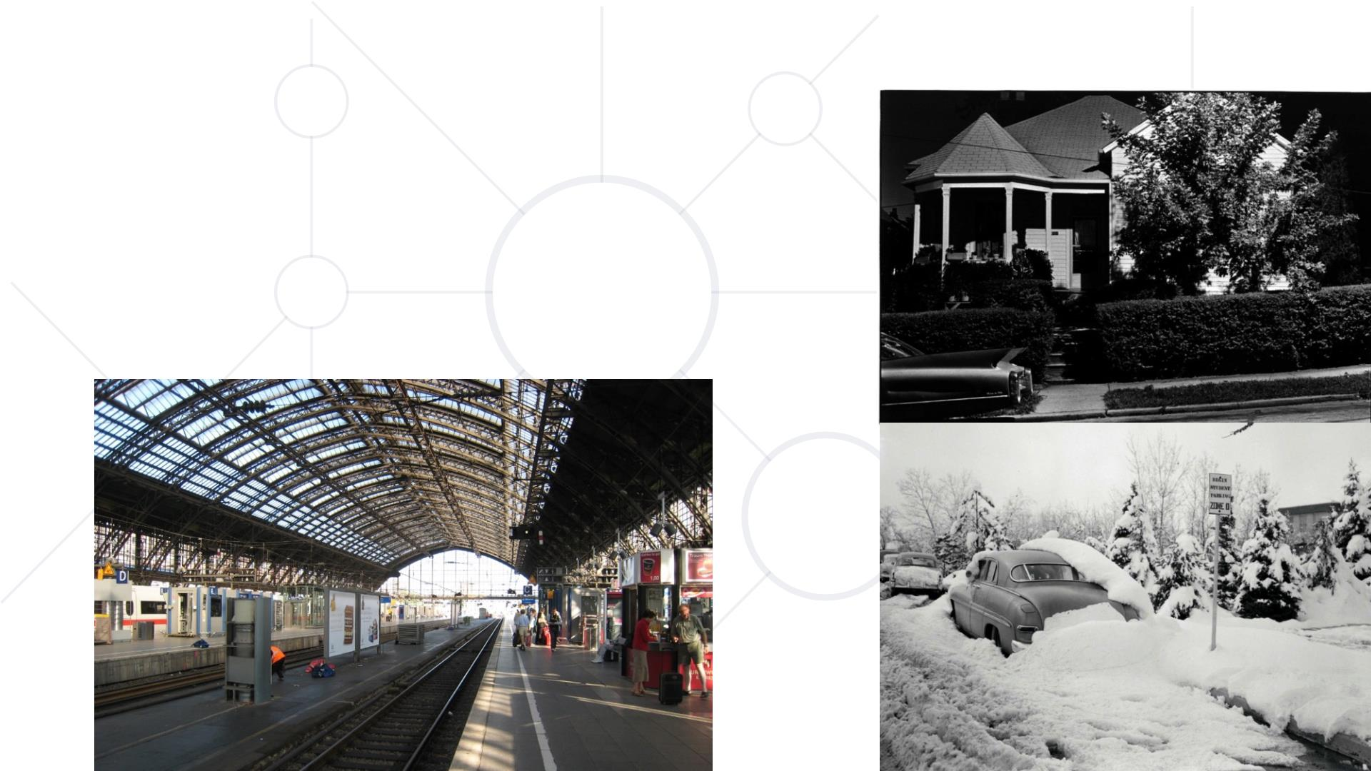
Signifiers
Social signs that indicate events from
the physical and social life that could
bear a certain meaning

Slide 70

Constraints
§ We limit how a product can be
used
§ They are conceptually the
opposite of affordances
§ Help us to avoid mistakes and
dangerous states
§ They can be physical, semantic,
logical and cultural

Slide 71

Physical constraints
§ Limit the number of physical actions
§ Embedded in the shape of the object
§ The more obvious they are the better they work

Slide 72

Semantic constraints
§ Based on general knowledge and the current context
§ Improve intuitiveness
§ Valid within a limited group of people

Slide 73

Logical constraints
§ Used to discard possible soluꢁons
§ They frequently embed constraints

Slide 74
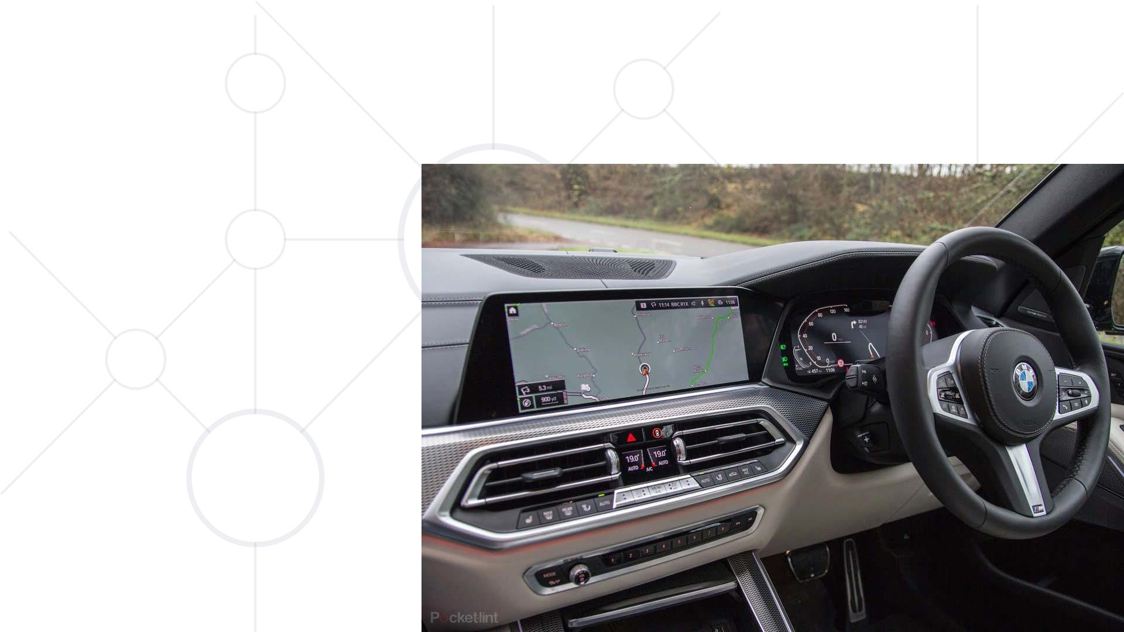
Cultural constraints
§ Based on
common cultural
norms
§ Applicable within
a limited group of
people

Slide 75
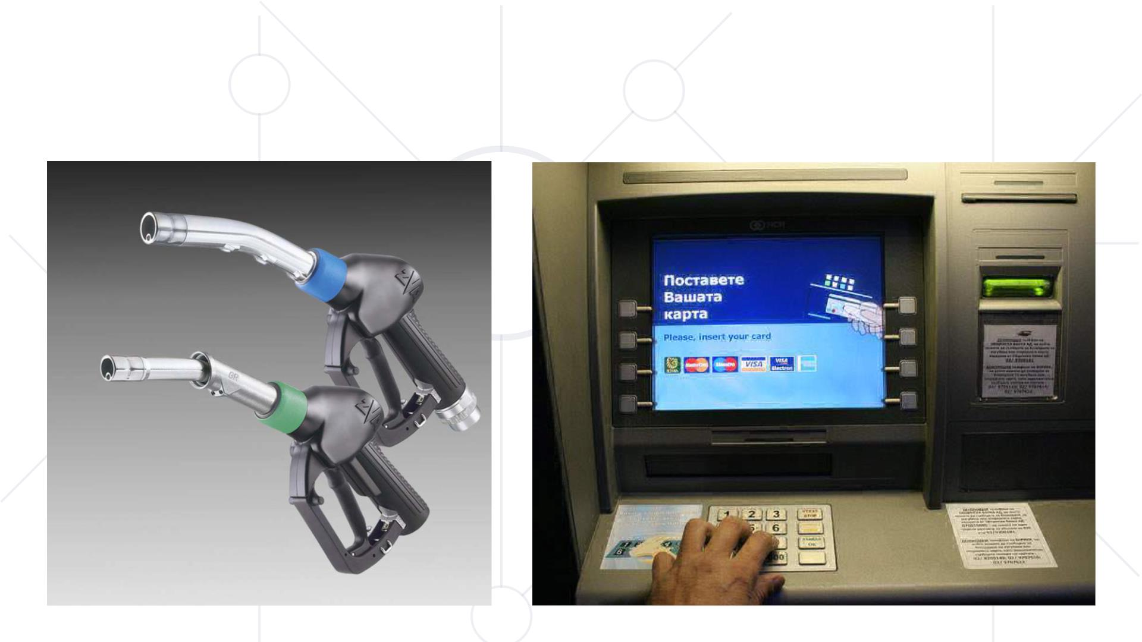
Constraints

Slide 76
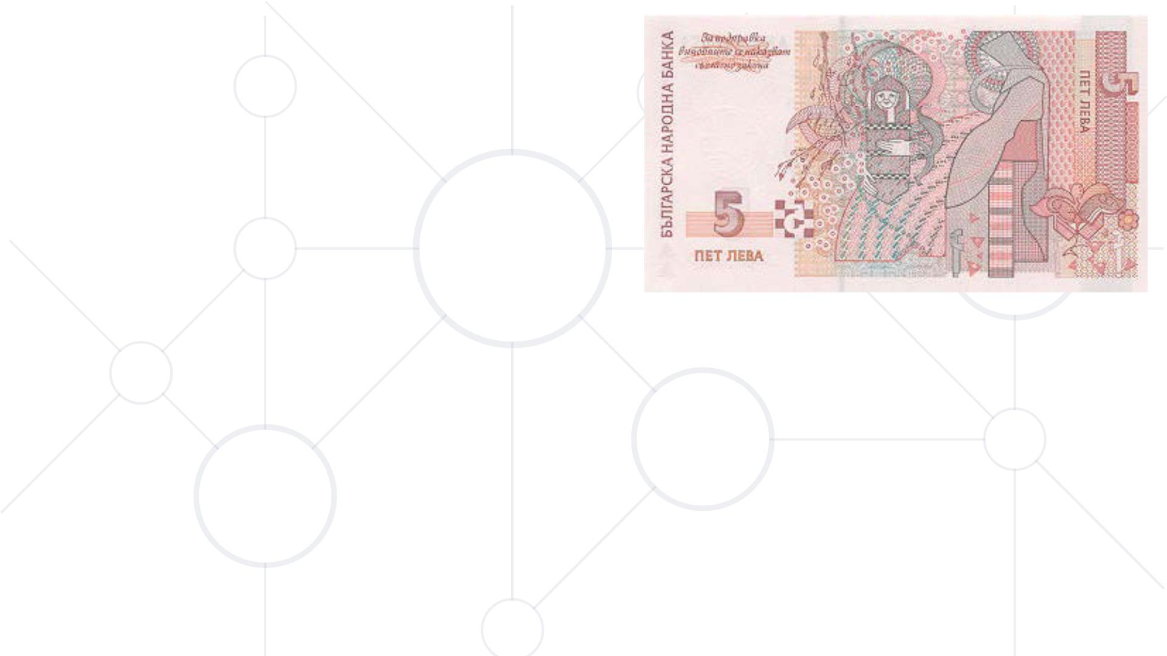
Types of knowledge
§ Much of the knowledge is in the world around
§ Our behavior is determined by the simultaneous use of what is
around us and our memory
§ Our memory need not be precise more than the allow us to
interpret our environment correctly
§ What is found on the back of the 5 leva bill?

Slide 77
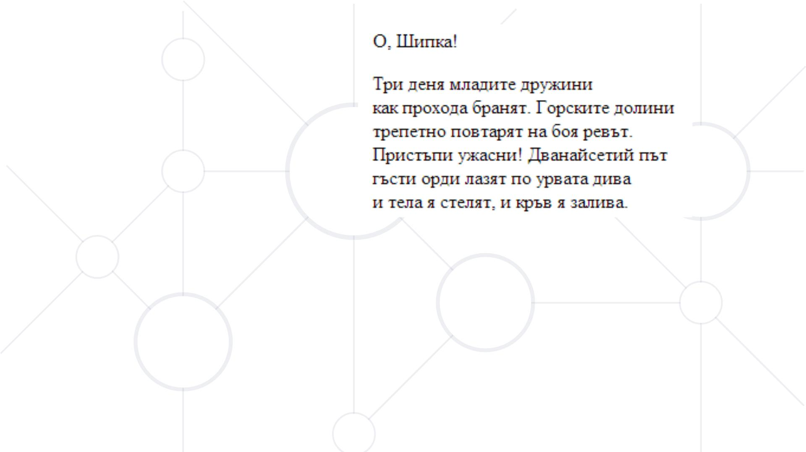
Improving memory
§ Constrains limit the number of items we memorize
§ There are certain techniques for improving memory through
lowering quantity, precision and depth of information

Slide 78
Types of knowledge
Knowledge of facts
Know-how
§ facts
§ rules
§ law
§ playing the guitar
§ driving
§ walking
§ easy to describe and
teach,
§ Subconscious, hard to
describe and teach, but
possible through showing
but not to learn

Slide 79

Memory capacity
§ Random facts we memorize not so wel
§ Connected facts we remember easier
§ What we understand get memorized th
§ Think about all the passwords, PINs, phone numbers, addresses
and birthdays you remember

Slide 80
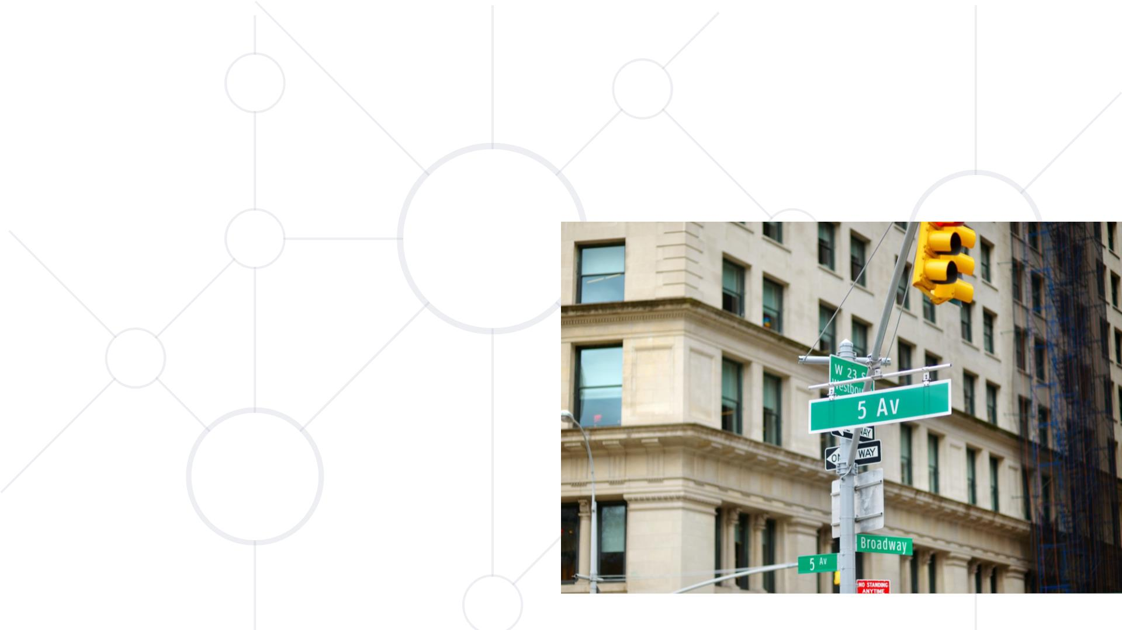
Knowledge in the world
§ No need to memorize, only to
interpret
§ It is always present for us to
perceive
§ Does not work if not important
in the current context
§ We can exploit it by leaving
reminders

Slide 81
Types of knowledge
Knowledge in the world
Knowledge in our mind
§ present to observe
§ relatively small size
§ no need to memorize § difficult for beginners
§ low eﬃciency § high efficiency
§ need for interpretaꢁon § hard to obtain
§ usable by beginners § invisible

Slide 82

Exercise
How are different
keyboard users
different from one
another – beginner /
advanced / experts?

Slide 83

Mistakes
§ People make constant mistakes with everyday products
§ Learned helplessness leads to disappointment and lower self
esteem of the users
§ The fault for an error is not user ’s but of the designer
§ It is not “dummies” who make mistakes but users with bad
conceptual models
§ Mistakes can be two types: learned and provoked

Slide 84

Learned Mistakes
§ Result from the formulaꢀon of a
wrong goal
§ Hard to spot because the user is
convinced, he does the right thing
§ They oꢂen regard important events
§ We make wrong assumpꢀons or faulty
causal relaꢀonships

Slide 85

Exercise
Share a personal
example of admitting
such conscious errors.

Slide 86

Provoked Mistakes
§ The most frequent mistakes we make
§ With the correct goal we make a mistake while executing the
action sequence
§ Small inaccuracies that we usually catch immediately
§ They often happen for frequent and largely subconscious
activities we perform

Slide 87
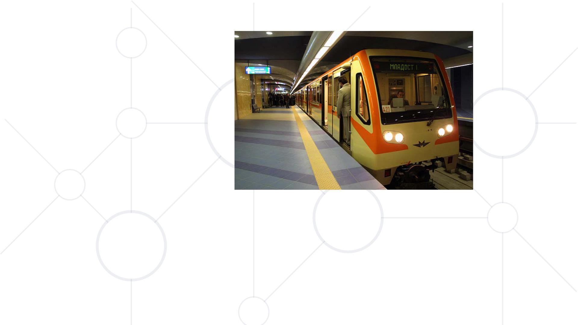
Capture errors
§ Tw o actions with very similar beginning but very different end
§ The more frequent action captures the less frequent one
§ Getting off the subway on the stop for work on a weekend

Slide 88

Bad description errors
§ Our intenꢁon lacks enough descripꢁon and allows for mulꢁple
acꢁon sequences
§ Takes place oꢀen with object that are near one another
§ Switching on one heater and placing the pan on another

Slide 89

Incoming information errors
§ Incoming information while we are following
the action sequence influences it
§ Dialing a phone number while the radio is on
and they announce the frequency
§ Typing a word document while listening to
music and entering its lyrics

Slide 90

Association errors
§ An internal association that we have provokes a wrong action
§ Thinking for last night at lunch and wishing someone good night
§ Calling people with wrong names because we think about
someone else

Slide 91

Forgeꢂng errors
§ We forget the goal while
executing the action sequence
§ We can reactivate the actions by
going back to where the goal was formed
§ We go next door to tell a colleague something and we can’t
remember what

Slide 92

Premature completion errors
§ We complete the acꢁon
prematurely because a large
porꢁon of it has been completed
§ A while ago a friend forgot his
credit card in a ꢁcket machine in
Berlin as he leꢀ with his train
ꢁcket once it got printed
§ How does and ATM funcꢁon

Slide 93
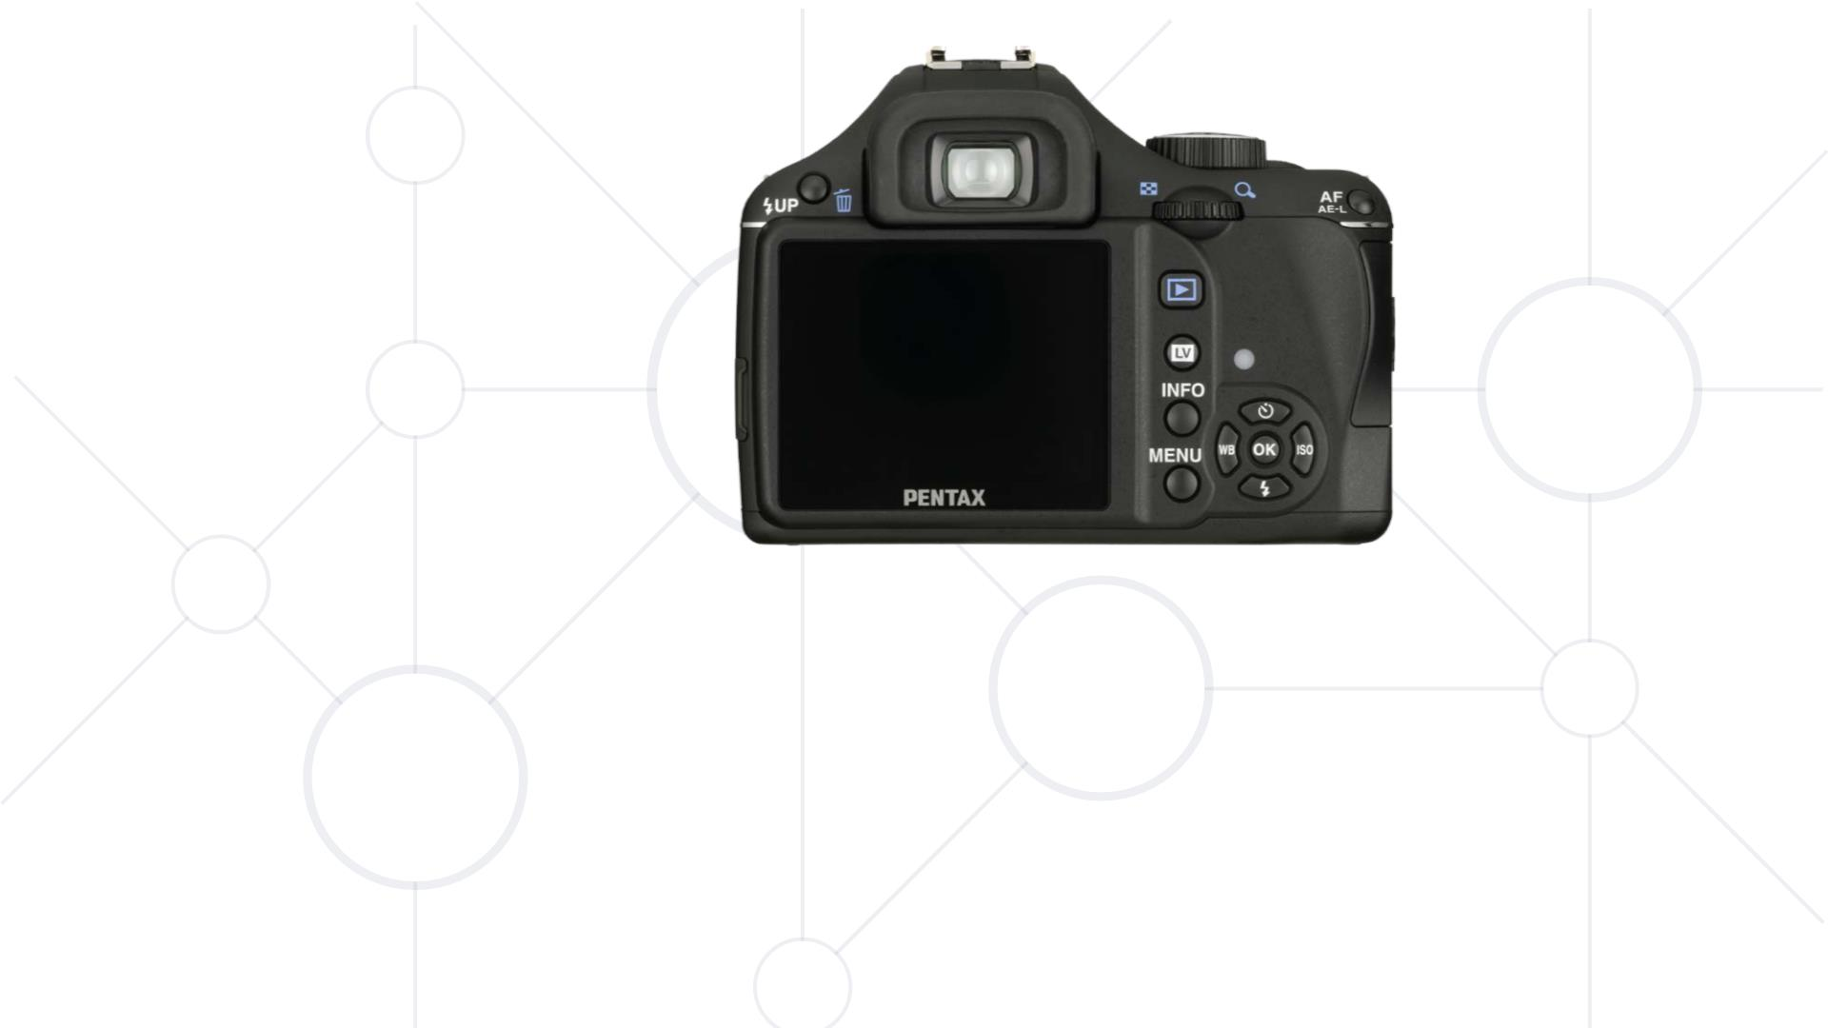
Mode errors
§ We face a device with different operating modes
§ We perform a wrong action because the system is in a different
mode from the one, we expect it to be
§ Most frequently met in digital and software products
§ Setting the exposure / shutter speed of a camera

Slide 94
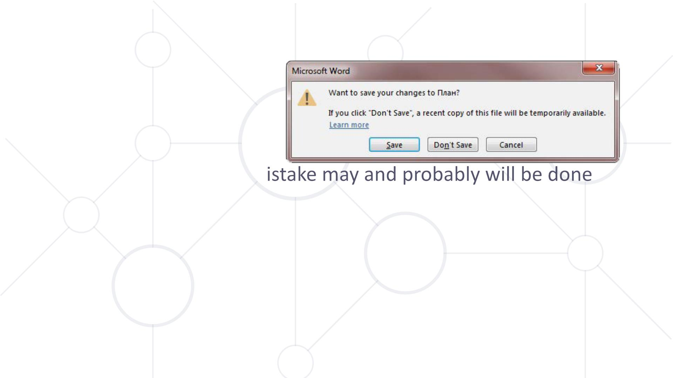
Design for errors
§ Admit that any possible m
§ Lower the possibility for the user to make mistakes
§ Soften the effect of a mistake when it occurs
§ Make mistakes easy to discover and undo
§ Users neglect warnings
§ Don’t punish your users for their mistakes

Slide 95

Handy Tip:
To understand more about your area of choice for your
project and the types of users who may be attracted to it,
create a survey and try to collect at least 20 responses to it.

Slide 96









SoftUni Partners
Notes:
96

